Slide 1


Using FFAR’s PowerPoint Template
UPDATED: November 22, 2024

Slide 2
Agenda
01
Using this Template
02
Standard FFAR Slides
03
Master Template

Slide 3

Using This Template

Slide 4
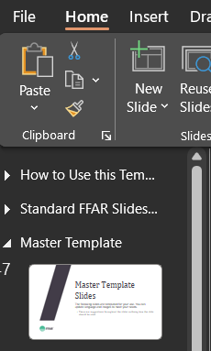
Template Sections
This deck contains three sections:
  Using this Template
  Standard FFAR Slides
  Master Template
Each section details how to use the slides within it. You can view or collapse the slides in each section in the left-hand banner by clicking the triangle at the left of each section.

Slide 5
Let Us Help
COMMUNICATIONS & LEGISLATIVE AFFAIRS TEAM CAN HELP
  This template helps you develop PowerPoint decks that are properly branded.
  Please use this template for all FFAR PowerPoint (PPT) presentations.
  Reach out to your Communication & Legislative Affairs (CommsLeg) point of contact (POC) as soon as the need for a PowerPoint arises, and we can develop slides for you.

Slide 6
Preparing Your Presentation
When preparing your presentation, consider:
  Who is the audience?
  What is the main point you want to convey?
  What is the format (in-person, virtual, panel, Q&A, etc.)?
  How much time do you have to present?
Build a message box (with your CommsLeg POC) before developing slides.
  DO NOT include the message box in your final presentation.
Discuss presentation logistics with your CommsLeg POC.
  Will you be advancing your slides or will someone else?
  Will you be able to see the screen with your presentation or is it behind you?
  Is there a screen to see your notes or do you need to print them?
  Did you build in preparation time for a practice session?

Slide 7
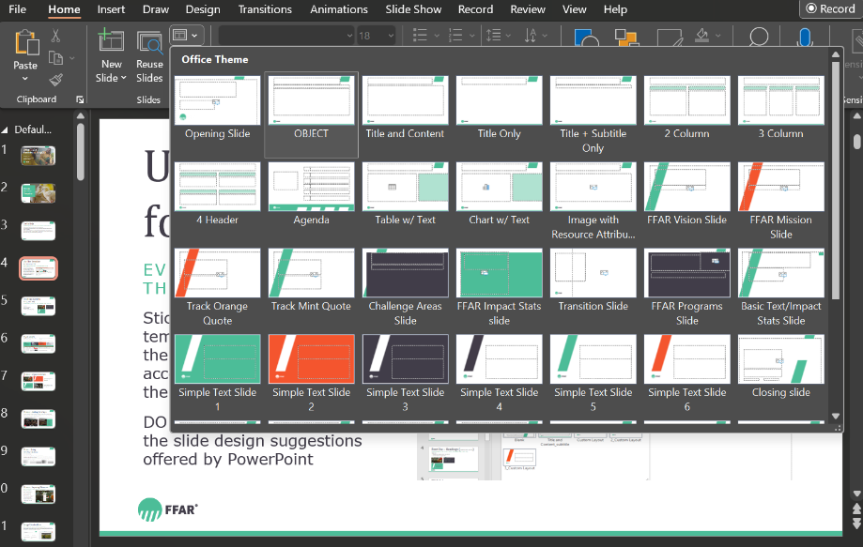
Use This Template for Every PPT
All branding elements are in this template
Stick to the branded slide templates programmed into the Layout function. You can access the layout drop-down menu on the Home tab.
DO NOT use the Design tab or the slide design suggestions PPT offers.
Access slide Layout options using this drop-down menu

Slide 8

Fonts & Sizes
Headings (Cambria font, size 60)
SUBHEADINGS (TEXT IS ALL CAPS, VERDANA FONT, SIZE 20)
Body text (Verdana font, size 20)
  First level bullets (Verdana, size 18)
    Second level bullets (Verdana, size 16)
      Third level bullets (Verdana, size 14)
All text is aligned left, always. DO NOT center text.

Slide 9
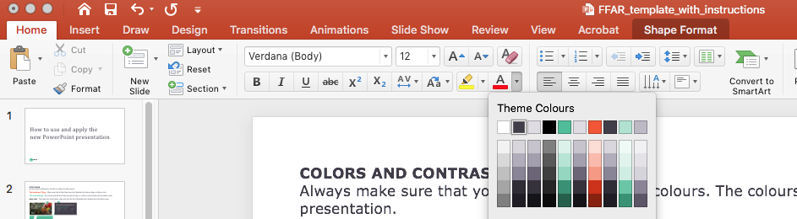

FFAR Colors
  All colors are pre-set in this template
  Always use FFAR’s brand colors.
  Hyperlinks are orange.
  All text is Dark Gray, Green or White. DO NOT use black.
  Avoid using the Green and Orange together.
The colors are pre-set Theme Colors drop-down menu, including colors for text, shapes and bullets.
GREEN
CMYK 66 / 0 / 53/ 0
RGB 76/ 189 / 152
HEX #4cbd98
PMS 338U / 2413C
DARK GREY
CMYK 71 / 68 / 51 / 42
RGB 65 / 61 / 73
HEX #413d49
PMS 533U / 2379C
BRIGHT ORANGE
CMYK 0 / 82/ 91 / 0
RGB 244 / 85 / 46
HEX #f4552e
PMS 2026U / 2026C
LIGHT GREY
CMYK 11 / 10 / 6 / 0
RGB 222 / 220 / 226
HEX #dedce2
PMS 5313U / 5313C

Slide 10




Adding Branded Bullets
Bullets should be branded as follows, not gray
To add branded bullets:
  On a blank line, click the Increase List Level button ( ) in the ribbon above.
    DO NOT click the Bullets button ( ). This will lose the branded bullet formatting.
  Your bullet should then appear with the FFAR green color.
    Then hit the Tab key on your keyboard or click the Increase List Level button from the ribbon above to increase to level 2.
      Hit Tab or click Increase List Level once more to indent to increase level 3.
    Hit the Shift and Tab keys (PC only) on your keyboard at the same time or click the Decrease List Level ( ) to decrease the list level.

Slide 11

Logo Usage
All slides must include the FFAR Logo.
When using the FFAR logo in PowerPoint, only use the “FFAR + Icon logo” option. This logo is the circle and the acronym FFAR, and is available on the branding page. The FFAR logo is already included on all slides in this template.

Slide 12
Photos & Images
Use high-quality images to tell your story
A picture is more engaging than text.
  Use high-quality, royalty-free and license-free images.
    Image theft, using an image without express permission, is illegal and violates copyright laws.
  Your CommsLeg POC can provide appropriate images.
    The CommsLeg Team stores all approved legal imagery in Box.
  Reference the FFAR branding page for photography use and guidelines.
To improve accessibility, DO NOT place text over images when creating new slides.
  The Standard FFAR Slides have text over images and were designed specifically to be accessible. Staff should not edit these slides.
  Staff are welcome to change the images on the Opening and Closing slides.
    Reach out to your CommsLeg Team if you need assistance changing images.

Slide 13
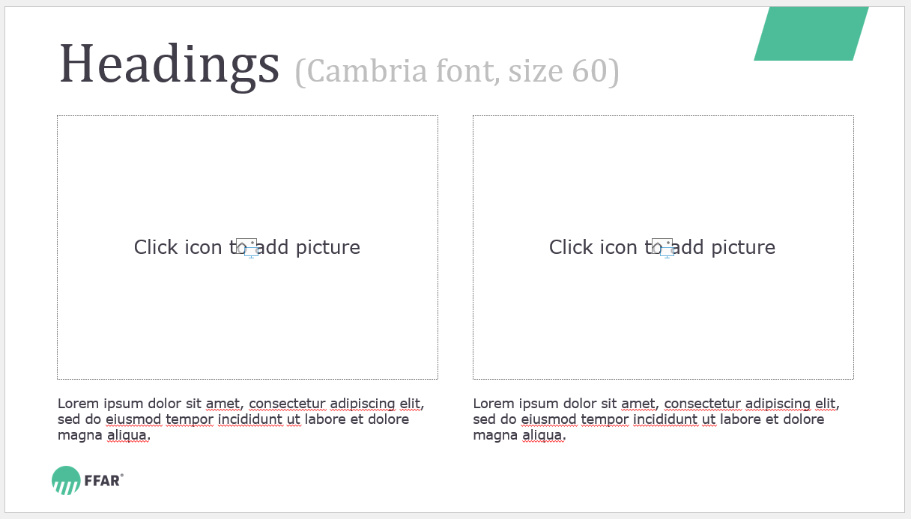
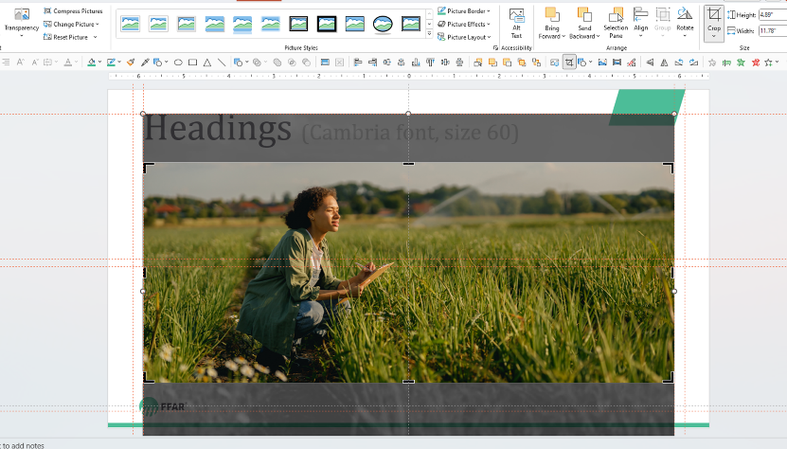
Adding Images
how to use & adjust image placeholders
Click the image icon to add a picture. Use the Picture Format tab to adjust the photo and click the Crop icon. Click and drag the picture within the placeholder to reposition the image if necessary.

Slide 14

Create Color Contrast
      DO NOT use dark text on a dark background or
light text on a light background.
      Instead choose text colors that create contrast against the background.

Slide 15
Use Icons Judiciously
GUIDE TO USING ICONS
Icons can effectively explain concepts visually and engage the viewer.
  Download icons for your PowerPoint presentations from The Noun Project. The login information is:
    Username: communications@foundationfar.org
    Password: Whitten536A!
  All icons must use FFAR branded colors. DO NOT use black. Color codes can be found on the branding page and slide 8: FFAR Colors.
  Icons should be in line and all the same size.
DO NOT use the Insert an Icon feature that is directly available in PowerPoint.

Slide 16
If You Must Include Lots of Text
THIS SLIDE IS FOR YOU
The CommsLeg Team strongly encourages you to talk through presentations and use PowerPoints for images, photos and graphs.
  Slides should include topline messages, not everything you want to say. Instead use the Notes section below to plan your talking points.
Use this slide sparingly in your presentations.
  Consider using animations to drop in the bullets as you discuss them. Here’s how:
    Click Animations in the top menu bar.
    Highlight the text you want to appear on the slide as you speak.
    Click Appear from the Animations options.
    Reorder your animations by clicking the orange number displayed next to the animated bullet.
      Click Move Earlier of Move Later found under Reorder Animation at the top right of the menu bar.

Slide 17
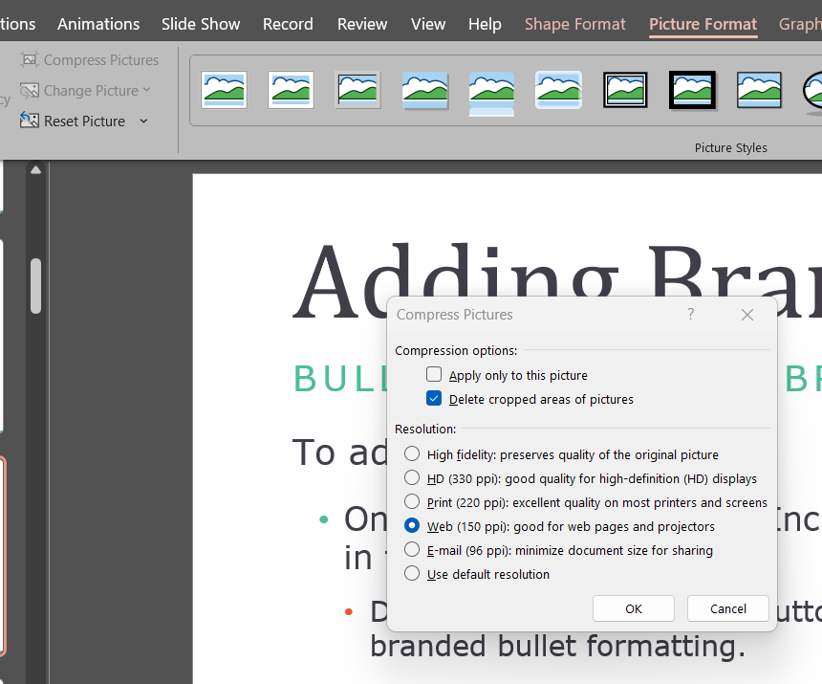
Compressing Photos
On a PC
To decrease the MB size of your PPT file:
Open your PowerPoint file on your desktop.
Select a slide that contains an image.
Select the image.
Click Picture Format from the ribbon above.
Click Compress Pictures.
Check Delete cropped areas of pictures.
Uncheck Apply only to this picture.
Choose Web (150 ppi).
Click OK.

Slide 18
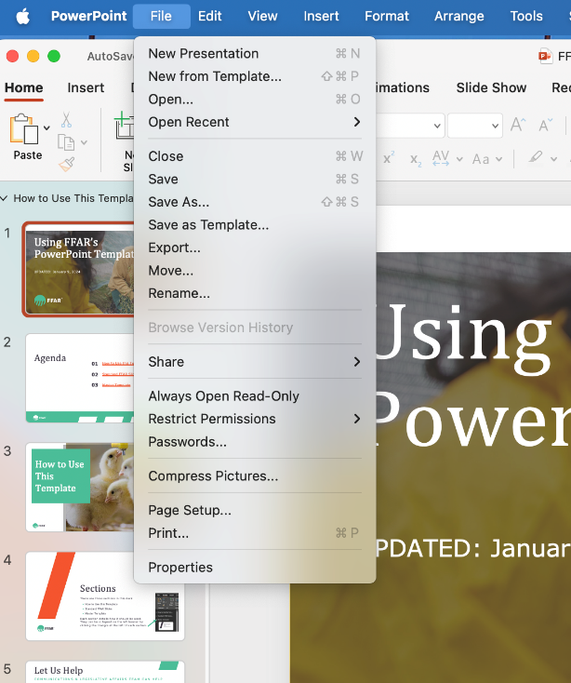
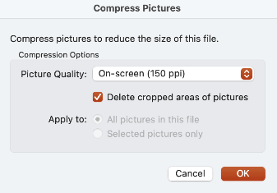
Compressing Photos
On a MAc
To decrease the MB size of your PPT file:
Open your PowerPoint file on your desktop.
Click the File tab in the upper left-hand corner.
Select Compress Pictures from the dropdown.
Select On Screen (150 ppi).
Check Delete cropped area of pictures.
Check apply to: All pictures in this file.
Click OK.

Slide 19
Sharing Your Deck
Ways to share your slide deck
  Save and share link directly from Box when sharing your deck internally with colleagues.
  Compress and email as an attachment when sharing your deck externally.
    Compressing the photos will allow you to email your deck as attachment.
  If necessary, save and share your deck as a PPT file via a link from Hightail, a secure, external file sharing cloud service.
    Login: Communications@foundationfar.org; Password: Lns1FB14skf!

Slide 20
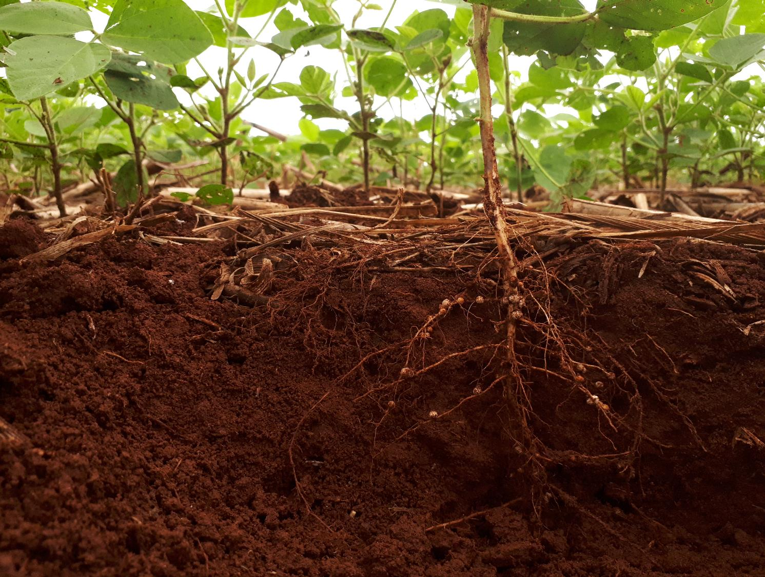
Standard FFAR Slides

Slide 21
Standard FFAR Slides
The following slides should be used to:
  Introduce FFAR
  Describe our unique funding model
  Provide a high-level overview of our grants and partners
  Highlight our Priority Areas and Consortia
DO NOT edit the slides in this section. Should the slides require updating, notify the CommsLeg Team.

Slide 22


About FFAR
FFAR, established in 2014 by the Farm Bill, connects funders, researchers and farmers to pioneer the next frontier of agriculture innovation.

Slide 23

Our Mission
We build collaborative partnerships to support audacious science addressing today’s food and agriculture challenges.

Slide 24

Our Vision
We envision a world in which pioneering, collaborative science provides every person access to affordable, nutritious food grown on thriving farms.

Slide 25




Funding Mechanisms
FFAR’s public-private partnerships advance food and agriculture research through four funding mechanisms:
Competitive Grants
Direct Awards
Prizes
Consortia

Slide 26
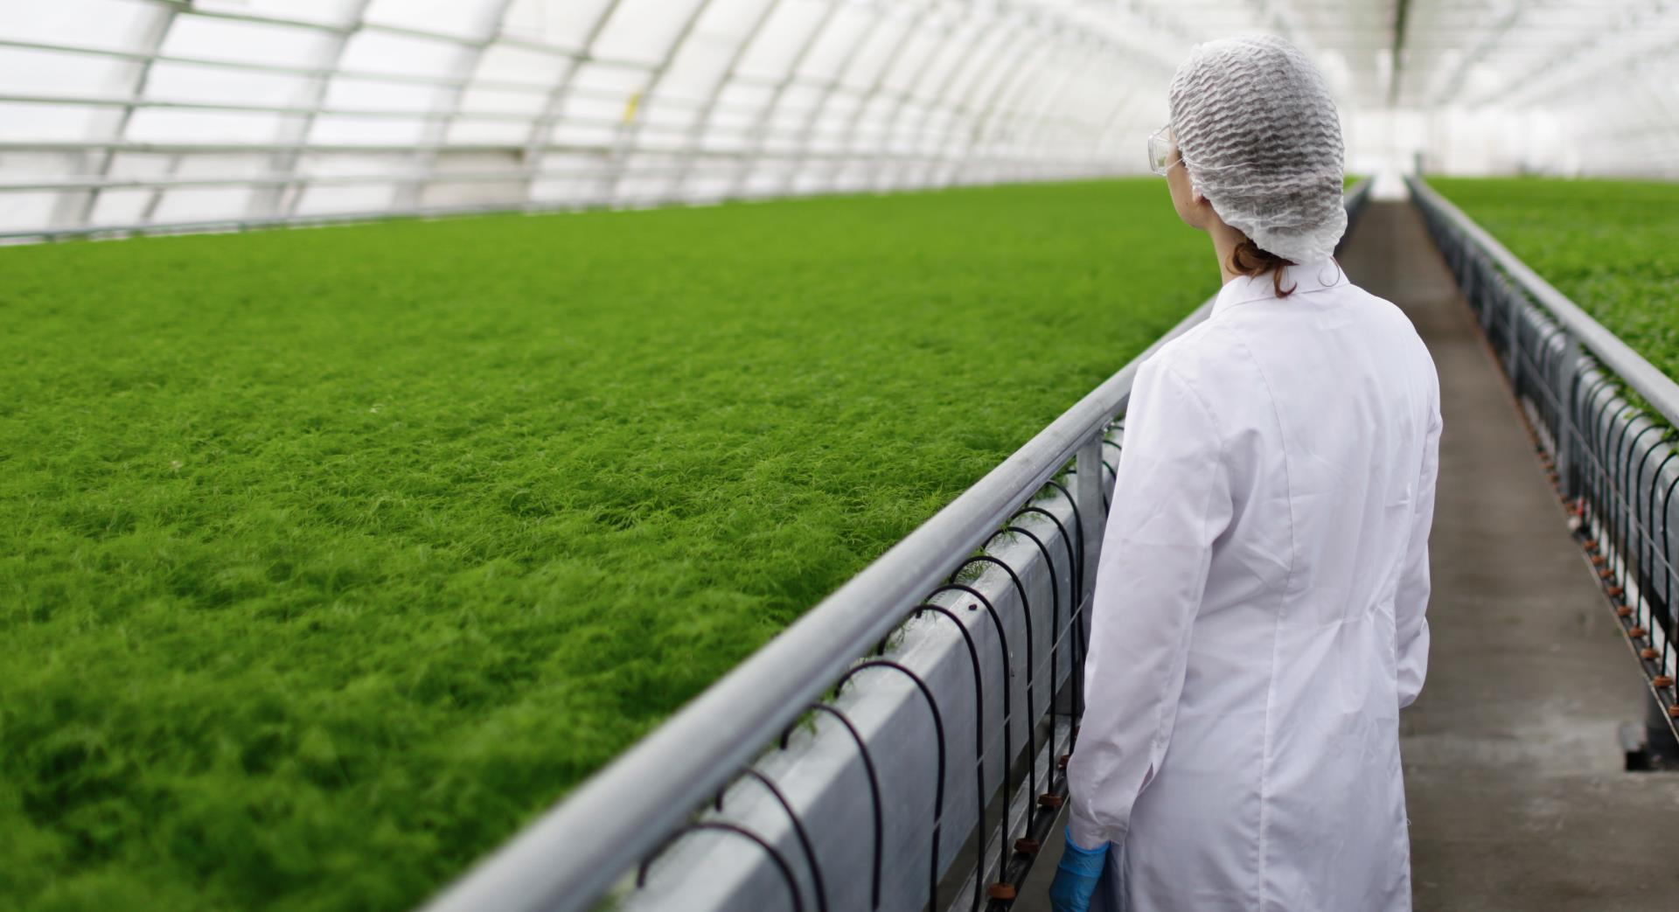
Research Benefits U.S. Economy
U.S. Department of Agriculture’s (USDA) Economic Research Service (ERS) found:
Public agricultural research investments generate $20 in U.S. economic benefits for every $1 spent.
Source: www.ers.usda.gov/amber-waves/2022/june/ investment-in-u-s-public-agricultural-research-and-development-has-fallen-by-a-third-over-past-two-decades-lags-major-trade-competitors/

Slide 27

The FFAR Factor
FFAR’s Research:
  Complements USDA’s research agenda
  Fills critical knowledge gaps
  Increases public agriculture research investments
  Focuses on actionable science
  Involves farmers to solve current challenges
  Moves research from the lab and into the field

Slide 28
FFAR’s Unique Model
HOW WE DIFFER FROM OTHER RESEARCH GRANTING AGENCIES
  Amplify funding and accelerate solutions
    FFAR's model multiplies the U.S. public research investment.
  Private sector collaborations
    FFAR's private sector partnerships ensure knowledge and solutions reach end-users.
  Rapid response funding
    Rapid Outcomes from Agricultural Research (ROAR) - deploys rapid response funding to address emerging pests and diseases.
  International science partnerships
    Dutch government collaboration on plant resilience smart breeding methods in model vegetable crops such as lettuce, tomato and potato.

Slide 29
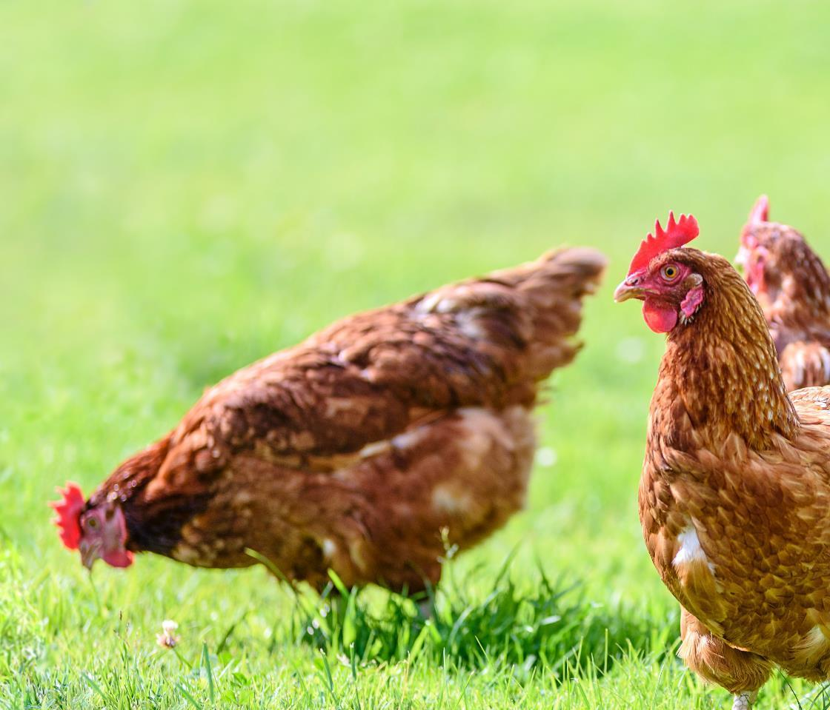
FFAR Grants by the Numbers
390+
GRANTS AWARDED
$1:$1.40
MATCHING RATIO
$775M
FUNDING AWARDED

Slide 30






















Funding Partners
FFAR HAS OVER 550 DISTINCT FUNDING PARTNERS, including:

Slide 31
We Fund Pioneering Research
BY FOCUSING ON THESE PRIORITY AREAS:
  Cultivating Thriving Production Systems
  Bolstering Healthy Food Systems
  Sustaining Vibrant Agroecosystems
  Strengthening the Scientific Workforce

Slide 32
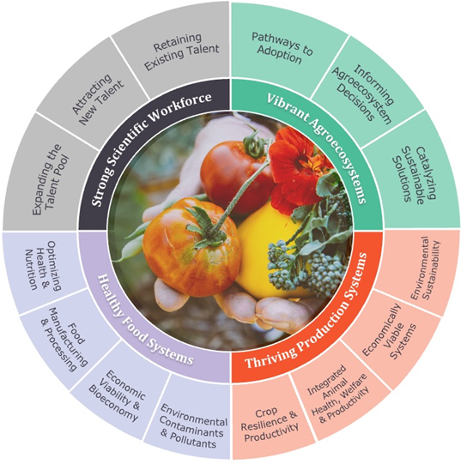
Research Themes
Within each Priority Area, a set of research themes inform the direction of FFAR-funded research and outline the high-level impacts FFAR seeks to achieve.

Slide 33

Cultivating Thriving Production Systems
Our Production Systems research supports animal and crop systems by increasing productivity, combating pests and diseases, supporting animal welfare and safeguarding farmers’ livelihoods.

Slide 34
Production System Themes
Crop Resilience & Productivity
Integrated Animal Health, Welfare & Productivity
Delivering crop productivity and resilience against biotic and abiotic stresses
Improving animal health and welfare while maintaining or increasing productivity
Economically Viable Systems
Environmental Sustainability
Designing and assessing adaptive, resilient production systems to advance farmers’ and ranchers’ profitability
Cultivating efficient crop and animal systems that protect and regenerate natural resources

Slide 35
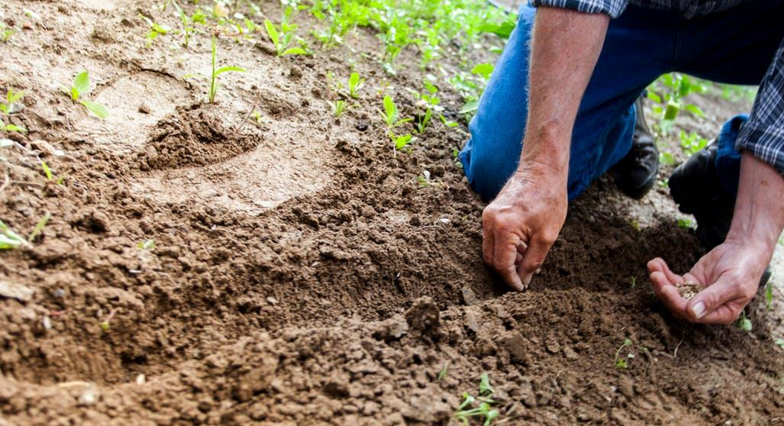
Sustaining Vibrant Agroecosystems
Our Agroecosystems research deepens our understanding of how agriculture systems interact with the surrounding environment to help farmers optimize resource use, address climate change and enhance farm productivity and resilience.

Slide 36
Agroecosystems Themes
Pathways to Adoption
Informing Agroecosystem Decisions
Catalyzing Sustainable Solutions
Emphasizing socio-economic and agronomic research to understand the drivers for producer decisions concerning regenerative agriculture and conservation practice adoption
Providing practical and credible information to help producers and other agriculture stakeholders evaluate tradeoffs associated with transitions to regenerative and conservation alternatives
Developing and refining knowledge, technology and practices that address present and future soil, water, climate and biodiversity challenges to enable productive and vibrant agroecosystems

Slide 37

Bolstering Healthy Food Systems
Our Food Systems research promotes the availability of nutritious foods, improves human health, develops novel food processes and products and advances the U.S. food system’s functionality.

Slide 38
Healthy Food System Themes
Optimizing Health & Nutrition
Food Manufacturing & Processing
Advancing novel foods, food products and systems-level approaches to enhance human health and nutrition
Enhancing the efficient and sustainable production and delivery of nutritious and safe-to-eat foods
Environmental Contaminants & Pollutants
Economic Viability & Bioeconomy
Mitigating the impacts of environmental contaminants on food and health, while reducing food system contaminants and increases human health resilience
Advancing a sustainable bioeconomy in which products are affordable for consumers and profitable for stakeholders

Slide 39
Strengthening the Scientific Workforce
Our scientific workforce programs continue our longstanding commitment to address critical shortages in research and scientific workforce training.

Slide 40

We Strengthen the Scientific Workforce
BY FOSTERING THESE PROGRAMS:
FFAR Fellows
New Innovators in Food and Agriculture
Kirchner
Food Fellowship
Tribal
Agriculture Fellowship
NAS Prize in
Agriculture Science
Veterinary Student Research Fellows
OCP Fellowship
Nature-Based
Solutions

Slide 41
Scientific Workforce Themes
Expanding the Talent Pool
Attracting New Talent
Retaining Existing Talent
Explores opportunities to increase the workforce pool by attracting talent from adjacent disciplines or attracting non-traditional agriculture researchers to work in agriculture research.
Identifying gaps in agricultural scientific workforce training - now and in the future.
Focusing specifically on new or underserved workforce needs in new or underserved populations
Developing opportunities centering around IDEA (Inclusion, Diversity, Equity and Access) principles, and/or provide IDEA resources to designed or existing programs

Slide 42






FFAR Consortia
Our consortia unite partners to achieve a shared goal.

Slide 43
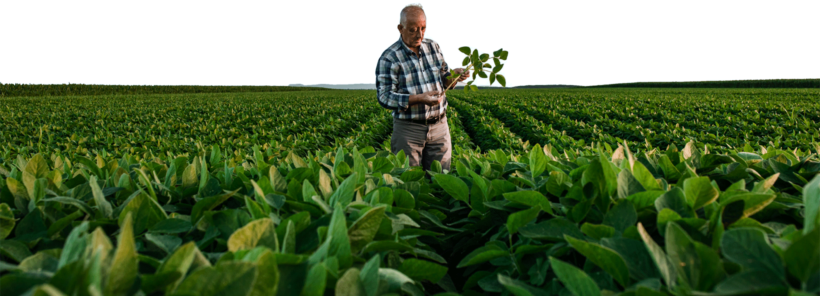



AgMission™
Together, FFAR and WFO established AgMission, a global initiative that unites farmers, ranchers and scientists to validate and accelerate adoption of climate-smart solutions at scale.
Our goal: Agriculture is net-zero for greenhouse gas (GHG) emissions.

Slide 44
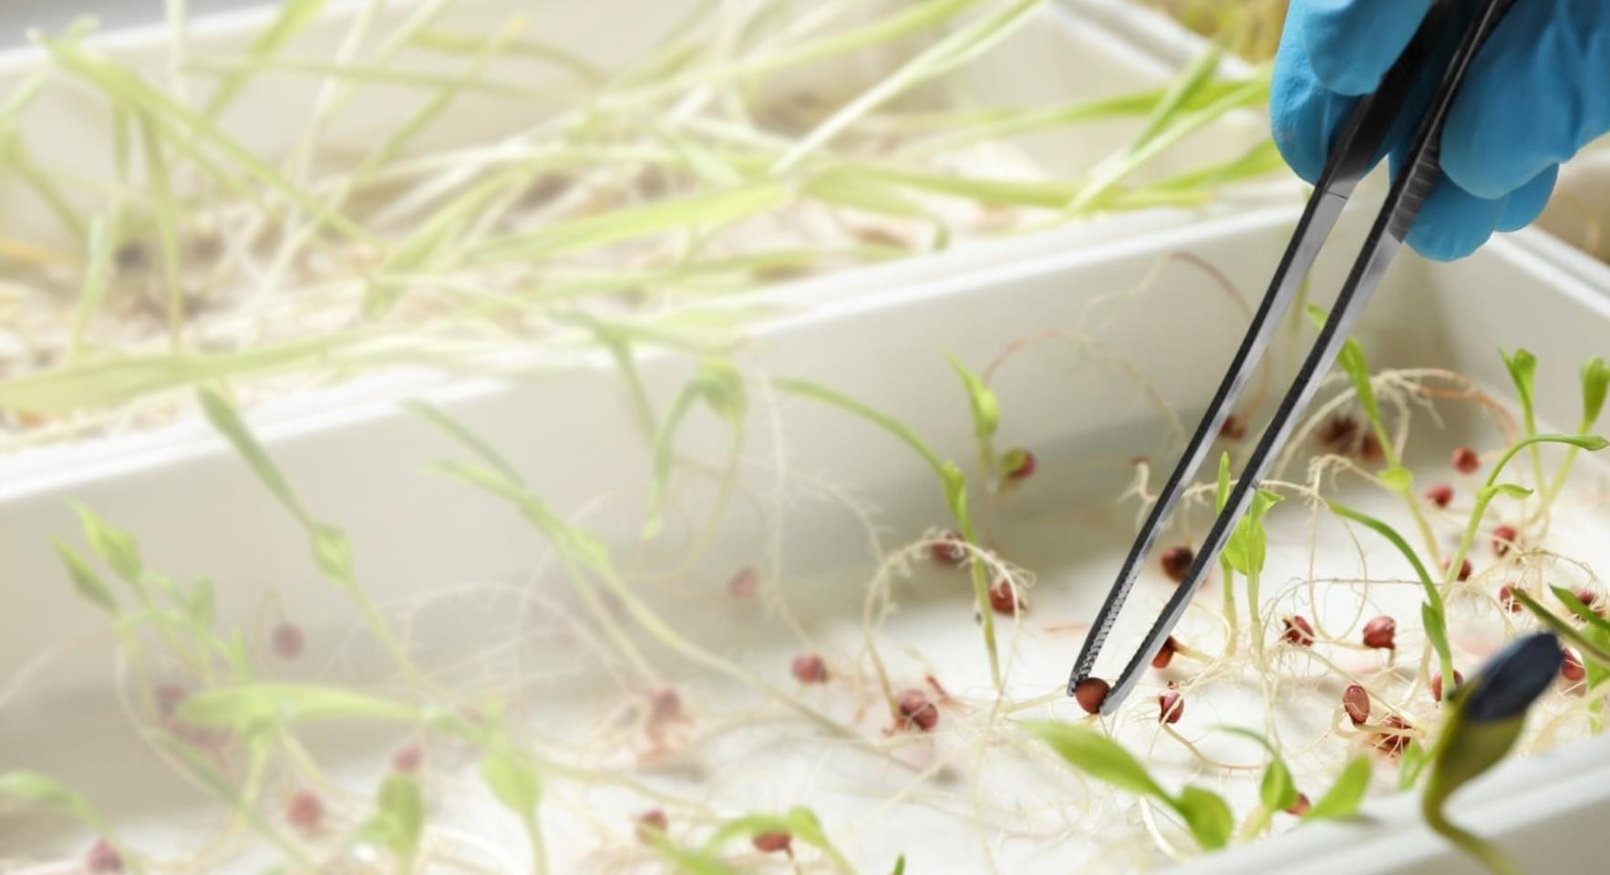

Crops of the Future
Crops of the Future (COTF), a public-private collaborative, expands knowledge of traits that give rise to characteristics crops need to adapt to a changing future

Slide 45


Efficient Fertilizer Consortium
The Efficient Fertilizer Consortium is a public-private partnership that funds research to advance enhanced efficiency and novel fertilizer products and practices that improve crop production and decrease environmental impact.

Slide 46
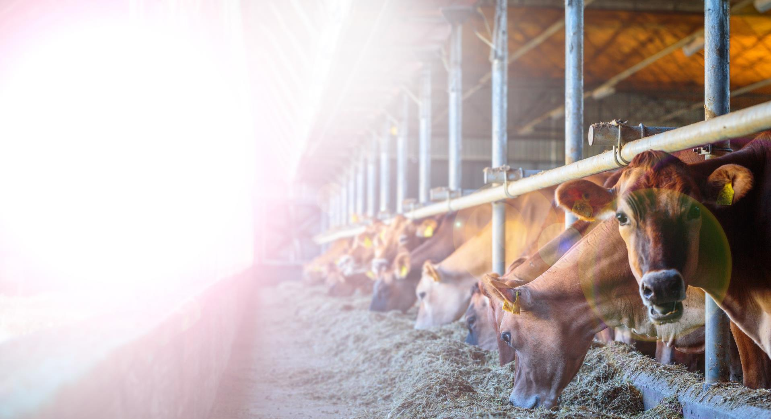

Greener Cattle Initiative
The Greener Cattle Initiative (GCI) is an industry-oriented consortium that supports research to mitigate enteric methane emissions from cattle.

Slide 47
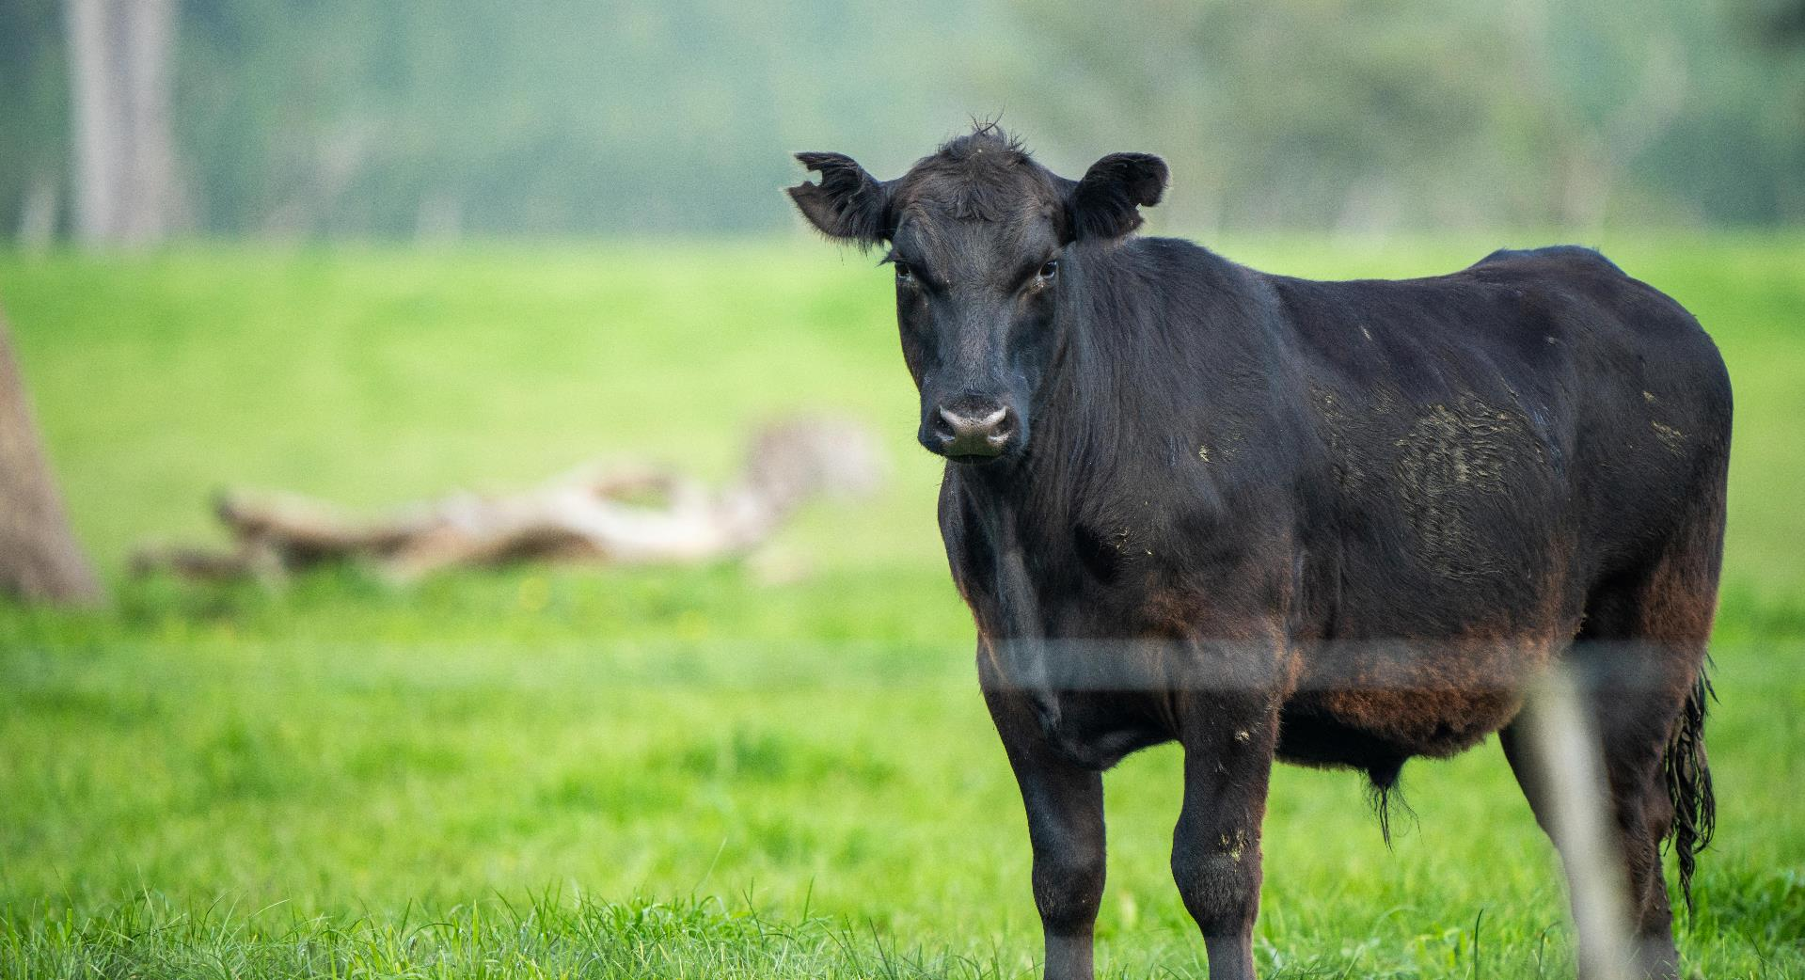

ICASA
The International Consortium for Antimicrobial Stewardship in Agriculture (ICASA) pioneers technologies and management practices that promote judicious antibiotics use to produce healthier livestock.

Slide 48


Precision Indoor
Plants
Precision Indoor Plants (PIP) consortium conducts research to grow flavorful, nutritious food indoors and increase our ability to produce valuable, quality crops.

Slide 49




FFAR Membership in Consortia
FFAR is a member of several consortia, which are managed by other organizations.

Slide 50
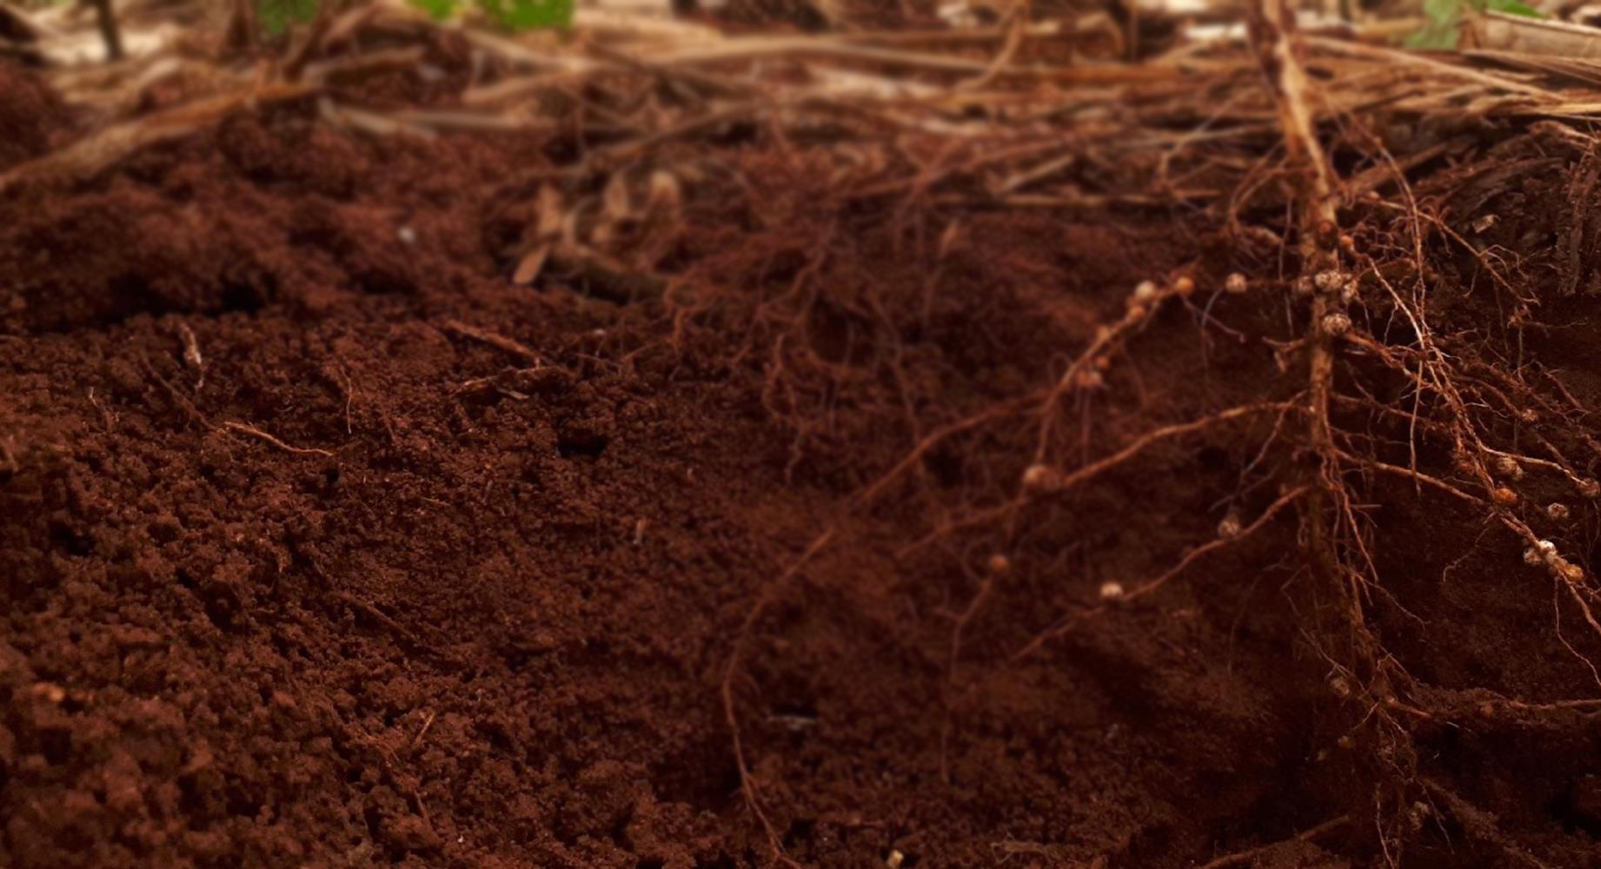

Ecosystem Services Market Consortium
The Ecosystem Services Market Consortium (ESMC) is a non-profit organization that improves the environment by exploring incentives to encourage adoption of agriculture practices. FFAR partners with ESMC to fund the consortium’s research to create a national ecosystem services market that generates social, economic and environmental outcomes that benefit producers, local communities, supply chain companies and consumers.

Slide 51


Hemp Research Consortium
The Hemp Research Consortium supports optimizing industrial hemp production.

Slide 52


Irrigation Innovation Consortium
The Irrigation Innovation Consortium (IIC) accelerates development and adoption of water and energy efficient irrigation technologies.

Slide 53



Innovation in
Post-Harvest Loss & Food Waste Reduction Consortium
The Innovation in Post-Harvest Loss & Food Waste Reduction Consortium conducts research to prevent food and nutrient loss and waste and promote global food security.

Slide 54
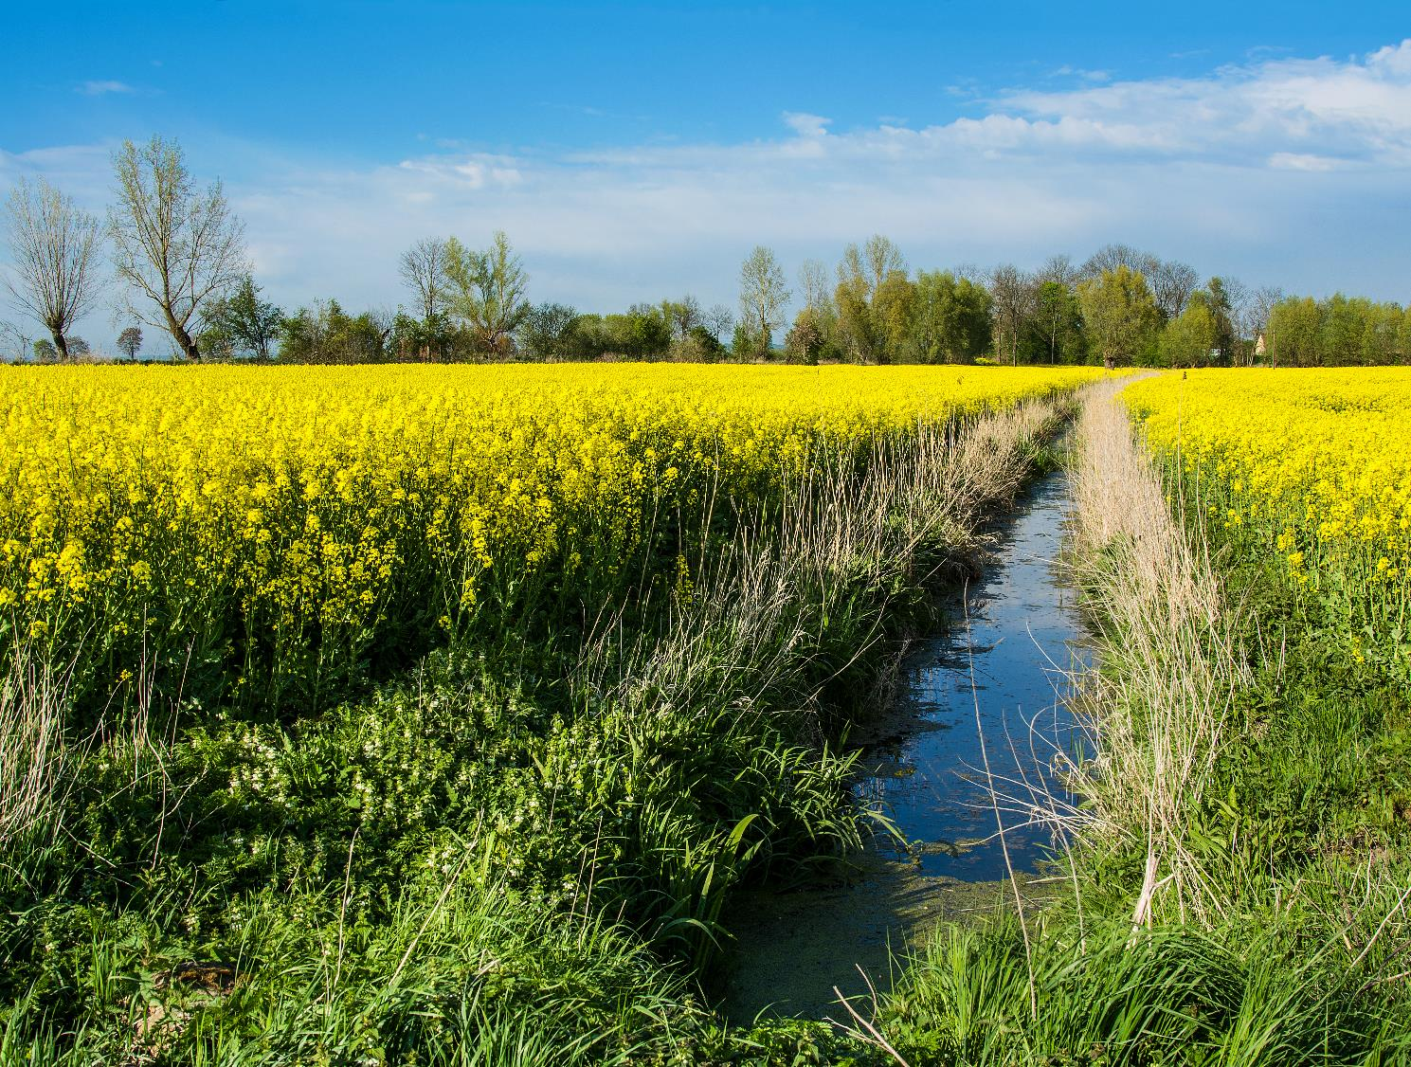
Master Template

Slide 55
Master Template Slides
The following slides templates are designed for your use. Please update language and images to meet your needs.
  DO NOT use the placeholder images, except for the Opening and Closing slides.
  We’ve included suggestions for best practices throughout these slides.

Slide 56

Opening Slide
General Option
MONTH XX, YEAR
(ex: APRIL 11, 2022)
Presenter Name (if relevant)
Location (if relevant)

Slide 57
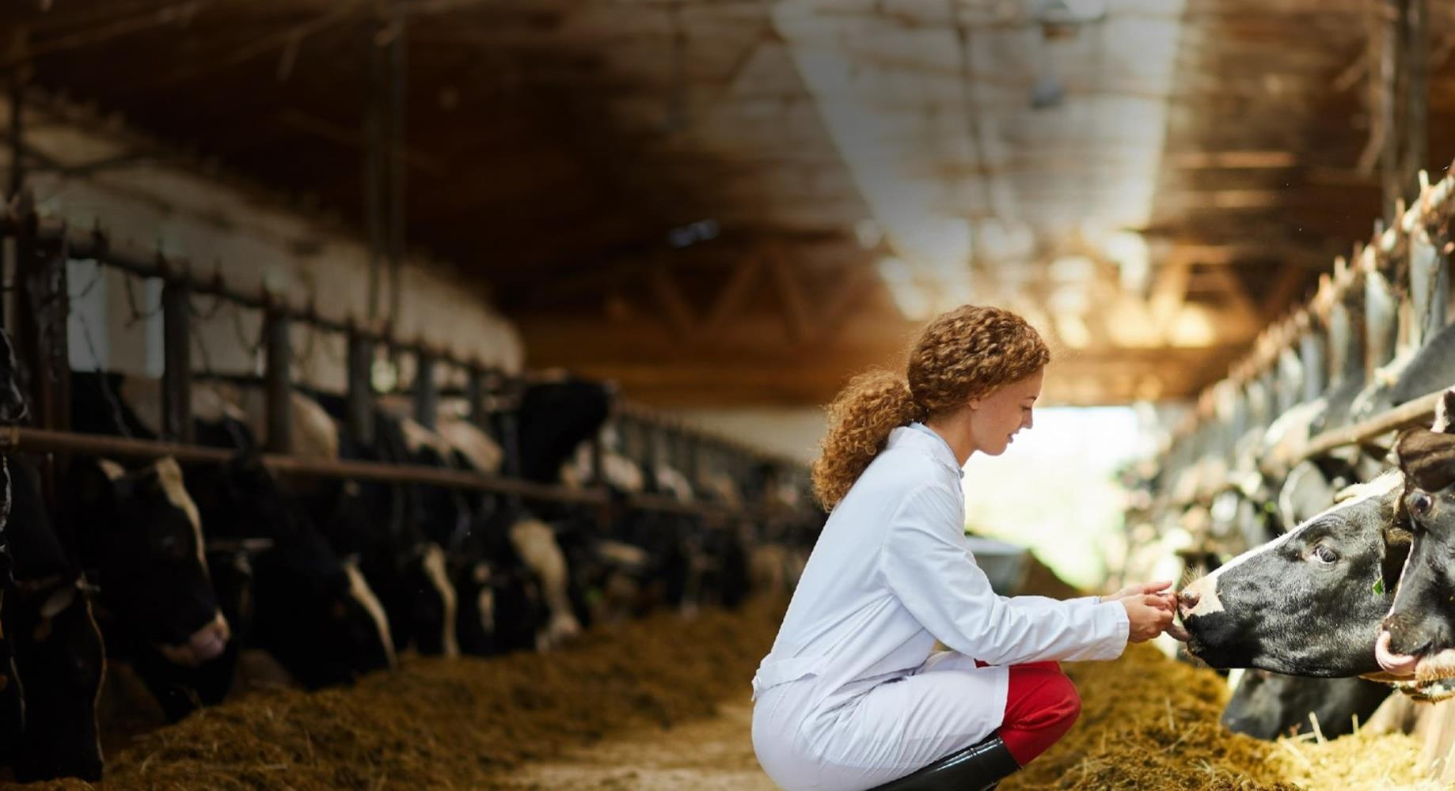
Cultivating Thriving Production Systems
MONTH XX, YEAR
Presenter Name (if relevant)
Location (if relevant)

Slide 58
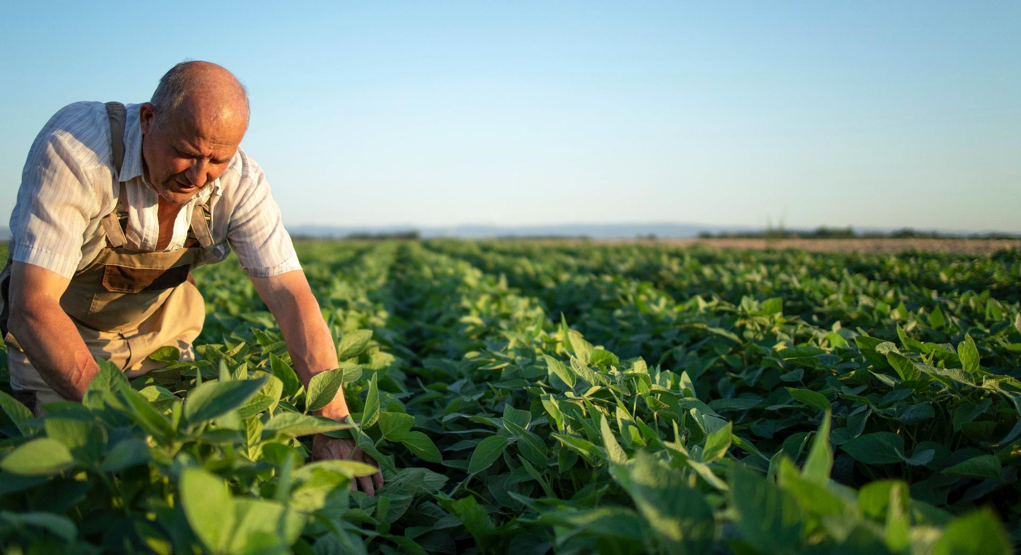
Cultivating Thriving Production Systems
MONTH XX, YEAR
Presenter Name (if relevant)
Location (if relevant)

Slide 59

Sustaining Vibrant Agroecosystems
MONTH XX, YEAR
Presenter Name (if relevant)
Location (if relevant)

Slide 60

Bolstering Healthy Food Systems
MONTH XX, YEAR
Presenter Name (if relevant)
Location (if relevant)

Slide 61

Strengthening the Scientific Workforce
MONTH XX, YEAR
Presenter Name (if relevant)
Location (if relevant)

Slide 62
Agenda
01
Welcome & Introduction
02
About FFAR
03
Partnership Highlights
04
Research & Impacts
05
Open Opportunities
06
Closing

Slide 63

“Use this slide when you want to highlight a quote or quick fact.”
JOHN SMITH, Sample company
Do not allow the text to pass the horizon and overlay the greenery.

Slide 64
Simple Text
This slide is for simple, brief text. Keep your text concise. For text longer than what is seen here, consider using the “Large Text Box” slide.
DO NOT move the title or text box. DO NOT place text or images on top of the FFAR Track.
You may expand the length of this text box to fill the space from here to the bottom of the slide
  Consider basic bullets

Slide 65

Simple Text
This slide is for simple, brief text. Keep your text concise. For text longer than what is seen here, consider using the “Large Text Box” slide.
DO NOT move the title or text box. DO NOT place text or images on top of the FFAR Track.
You may expand the length of this text box to fill the space from here to the bottom of the slide
  Consider basic bullets

Slide 66
Simple Text
This slide is for simple, brief text. Keep your text concise. For text longer than what is seen here, consider using the “Large Text Box” slide.
DO NOT move the title or text box. DO NOT place text or images on top of the FFAR Track.
You may expand the length of this text box to fill the space from here to the bottom of the slide
  Consider basic bullets

Slide 67
Simple Text
This slide is for simple, brief text. Keep your text concise. For text longer than what is seen here, consider using the “Large Text Box” slide.
DO NOT move the title or text box. DO NOT place text or images on top of the FFAR Track.
You may expand the length of this text box to fill the space from here to the bottom of the slide
  Consider basic bullets

Slide 68
Simple Text
This slide is for simple, brief text. Keep your text concise. For text longer than what is seen here, consider using the “Large Text Box” slide.
DO NOT move the title or text box. DO NOT place text or images on top of the FFAR Track.
You may expand the length of this text box to fill the space from here to the bottom of the slide
  Consider basic bullets

Slide 69
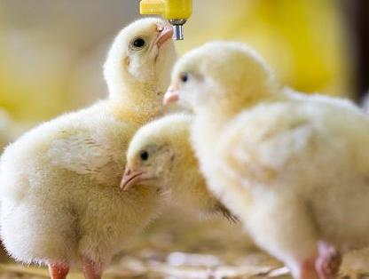
Transition Slide
(Use this slide to introduce a new topic.)

Slide 70

Transition Slide
(Use this slide to introduce a new topic.)

Slide 71

Transition Slide
(Use this slide to introduce a new topic.)

Slide 72
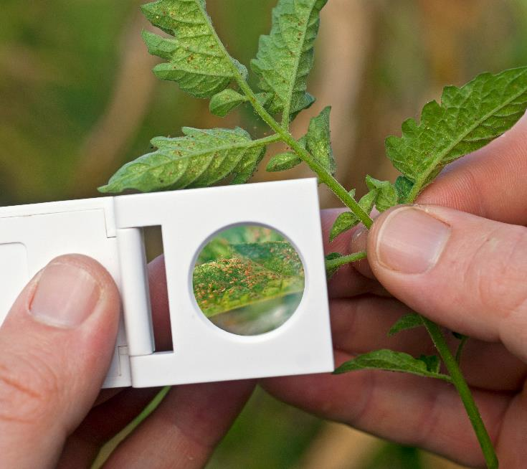
Image Slide (Cambria font, size 60)

Slide 73

Image Slide (Cambria font, size 60)

Slide 74
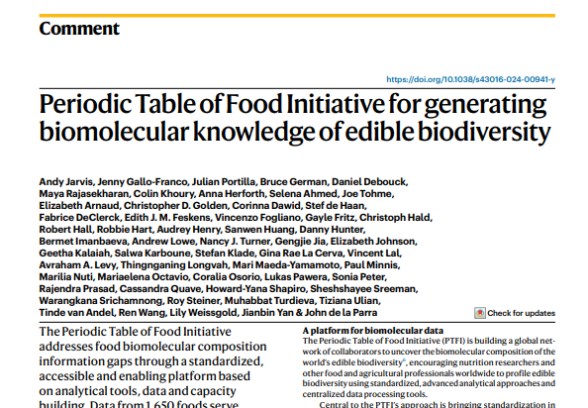

Images Slide (Cambria font, size 60)
Source: Nature; Jarvis, A., Gallo-Franco, J., Portilla, J. et al. Periodic Table of Food Initiative for generating biomolecular knowledge of edible biodiversity. Nat Food 5, 189–193 (2024). https://doi.org/10.1038/s43016-024-00941-y
Fontoura, A., Javaid, A., Sáinz de la Maza-Escolà, V., Salandy, N., Fubini, S., Grilli, E., & McFadden, J. (2022). Heat stress develops with increased total-tract gut permeability, and dietary organic acid and pure botanical supplementation partly restores lactation performance in Holstein dairy cows. Journal of Dairy Science, 105(9), 7842-7860. https://doi.org/10.3168/jds.2022-21820

Slide 75

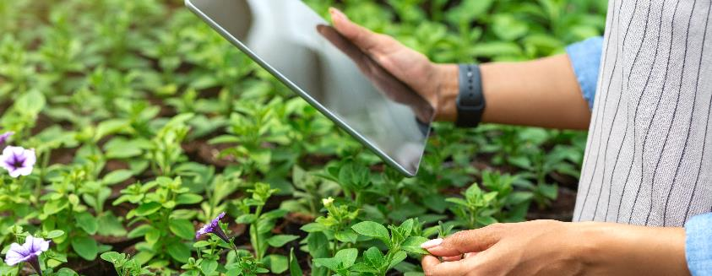

Images Slide (Cambria font, size 60)
Briefly describe what you want your audience to glean from the image. Provide attribute, when needed.

Slide 76
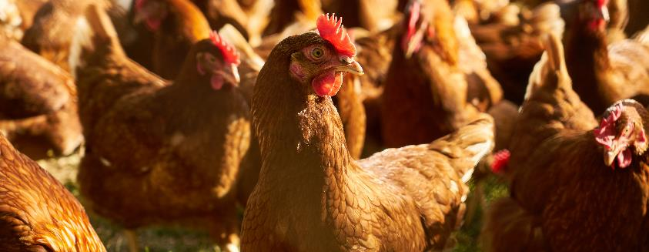


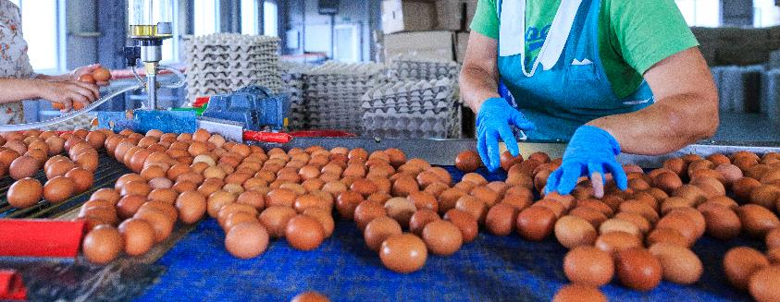
Images Slide (Cambria font, size 60)

Slide 77
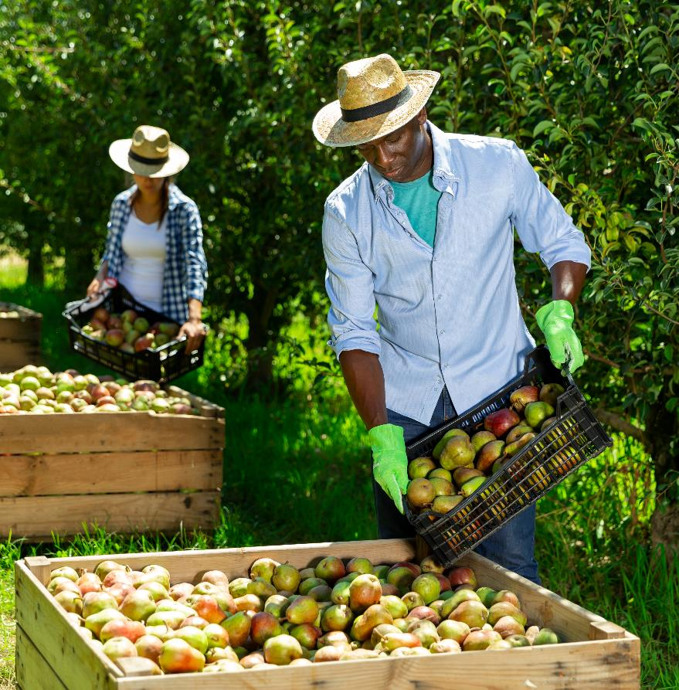
Image with Content
This slide is for simple text with one picture.
  DO NOT move the title or text box.
  DO NOT place text on top of image.
  You may expand the length of this text box to fill the space from here to the bottom of the slide.

Slide 78

Image with Content
This slide is for simple text with one picture.
  DO NOT move the title or text box.
  DO NOT place text on top of image.
  You may expand the length of this text box to fill the space from here to the bottom of the slide.

Slide 79
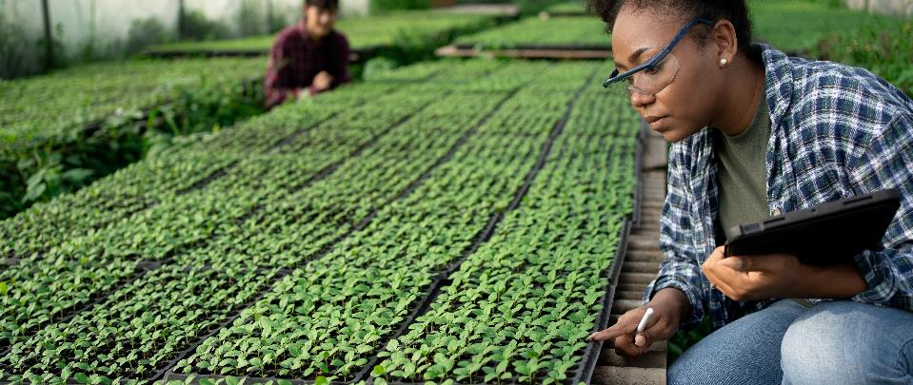
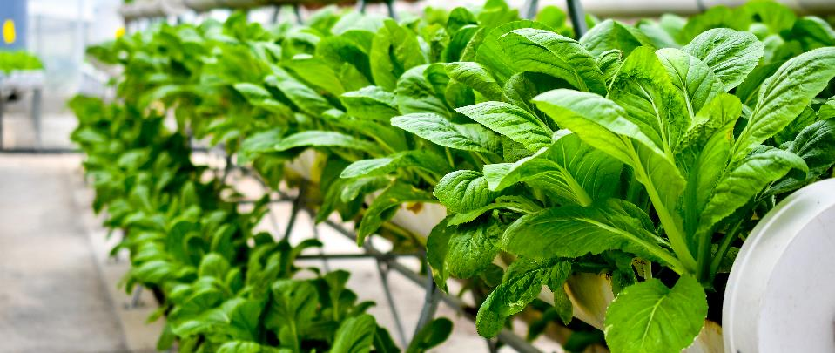
Two Images with Content
This slide is for simple text with two pictures.
  DO NOT move the title or text box.
  DO NOT place text on top of image.
  You may expand the length of this text box to fill the space from here to the bottom of the slide.

Slide 80
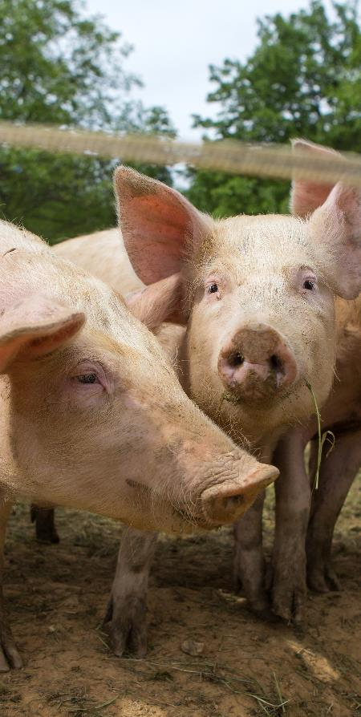
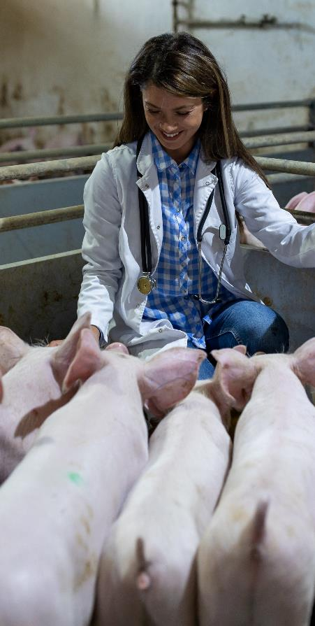
Two Images with Content
This slide is for simple text with two pictures.
  DO NOT move the title or text box.
  DO NOT place text on top of image.
  You may expand the length of this text box to fill the space from here to the bottom of the slide.

Slide 81
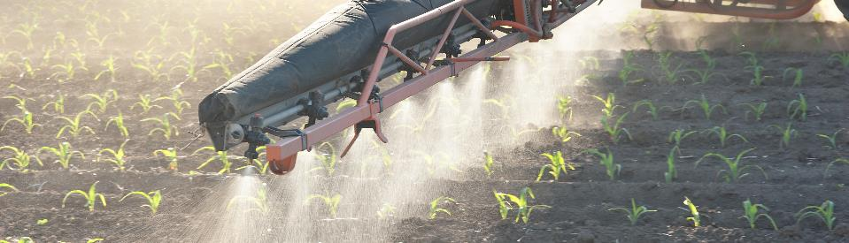
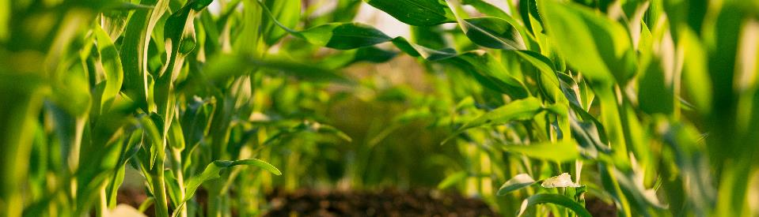

Three Images with Content
This slide is for simple text with two pictures.
  DO NOT move the title or text box.
  DO NOT place text on top of image.
  You may expand the length of this text box to fill the space from here to the bottom of the slide.

Slide 82
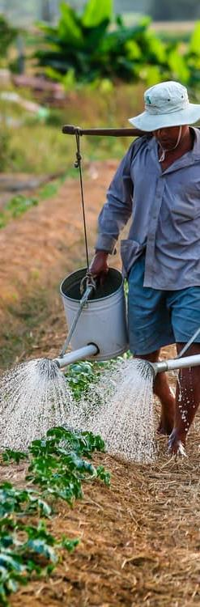


Three Images with Content
This slide is for simple text with two pictures.
  DO NOT move the title or text box.
  DO NOT place text on top of image.
  You may expand the length of this text box to fill the space from here to the bottom of the slide.

Slide 83
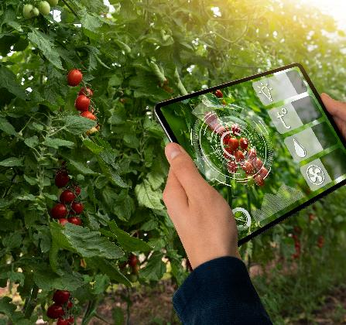
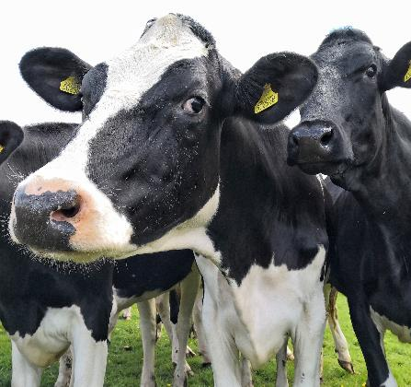
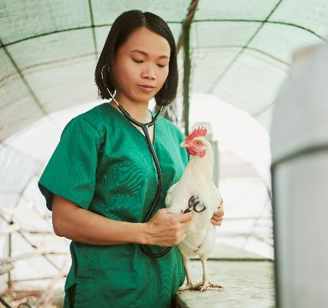
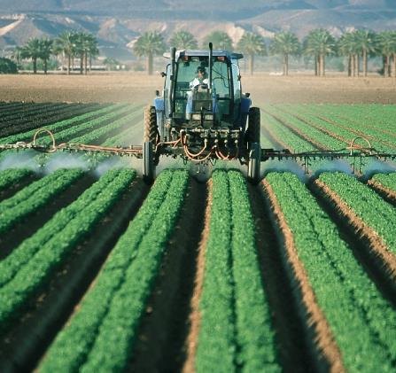
Four Images with Content
This slide is for simple text with two pictures.
  DO NOT move the title or text box.
  DO NOT place text on top of image.
  You may expand the length of this text box to fill the space from here to the bottom of the slide.

Slide 84

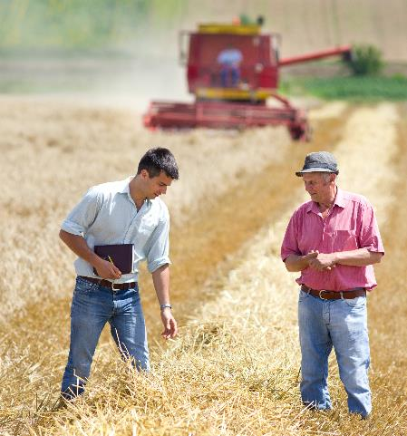
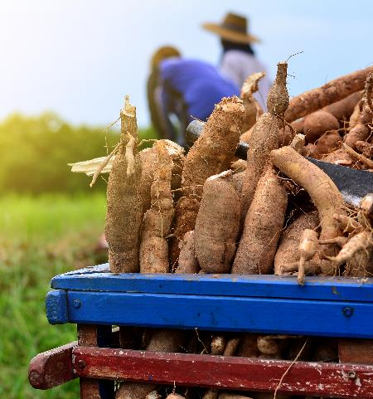
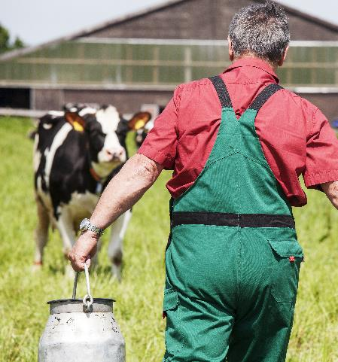
Four Images with Content
This slide is for simple text with four pictures. DO NOT move the title or text box to preserve the white space. DO NOT place text on top of the image.
You may expand the length of this text box to fill the space from here to the bottom of the slide
  Consider basic bullets

Slide 85
If You Must Include Lots of Text
THIS SLIDE IS FOR YOU
The CommsLeg Team strongly encourages you to talk through presentations and use PowerPoints for images, photos and graphs.
  Slides should include topline messages, not everything you want to say. Instead use the Notes section below to plan your talking points.
Use this slide sparingly in your presentations.
  Consider using animations to drop in the bullets as you discuss them. Here’s how:
    Click “Animations” in the top menu bar.
    Highlight the text you want to appear on the slide as you speak.
    Click “Appear” from the Animations options.
    Reorder your animations by clicking the orange number displayed next to the animated bullet.
      Click “Move Earlier” of “Move Later” found under “Reorder Animation” at the top right of the menu bar.

Slide 86
Data Points & Body Text
XX Number of Item
XX Years of Study
$$ Dollars Invested
This slide is for simple data points with brief explanation text. DO NOT move the title or text box to preserve the white space. DO NOT place text on top of the image.
You may expand the length of this text box to fill the space from here to the bottom of the slide
  Consider basic bullets

Slide 87
Two Column Data
Section Header
Section Header
Use this space to
  Highlight data
  Demonstrate order
  Outline steps or process
This is what the first list level bullet looks like. Keep hitting tab to go to the next level bullet.
  Second bullet
    Third bullet

Slide 88
Three Column Data
Section Header
Section Header
Section Header
Use this space to highlight data.
Use this space to demonstrate order.
Use this space to outline steps or process.
This is what the first list level bullet looks like. Keep hitting tab to go to the next level bullet.
  Second bullet
    Third bullet
Keep text brief.

Slide 89
Four Quadrant Data
Section Header
Section Header
Use this space to highlight data.
Use this space to demonstrate order.
Use this space to outline steps or process.
This is what the first list level bullet looks like. Keep hitting tab to go to the next level bullet.
  Second bullet
    Third bullet
Section Header
Section Header
Keep text brief.
Use “Animations” as needed.

Slide 90
Chart with Text
Summarize
  What is the main point to highlight?
  What do you want your audience to remember from this chart?

Slide 91
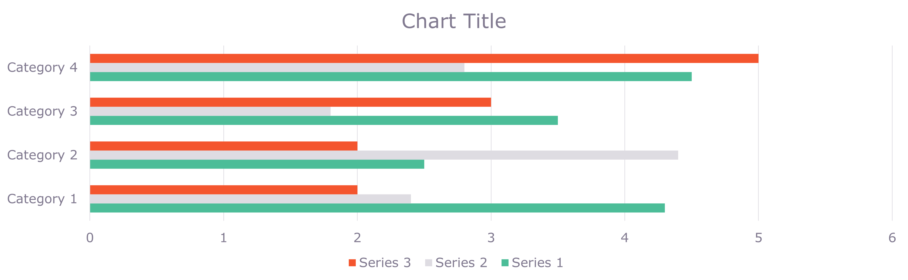
Simple Chart

Slide 92
Table with Text
Category 1 | Category 2 | Category 3 | Category 4
Summarize
  What is the main point to highlight?
  What do you want your audience to remember from this chart?

Slide 93


Universal Closing Slide
Presenter Name
  Email
  Phone Number
FOUNDATIONFAR.ORG
202.624.0700

Slide 94
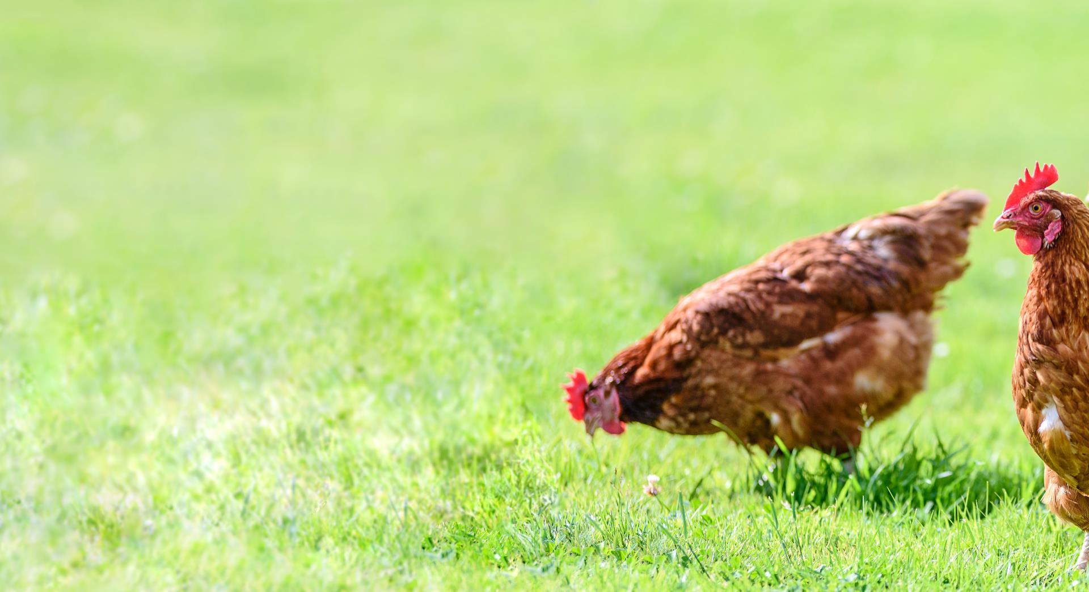
Cultivating Thriving Production Systems
Presenter Name
  Email
  Phone Number
FOUNDATIONFAR.ORG
202.624.0700

Slide 95

Cultivating Thriving Production Systems
Presenter Name
  Email
  Phone Number
FOUNDATIONFAR.ORG
202.624.0700

Slide 96

Sustaining Vibrant Agroecosystems
Presenter Name
  Email
  Phone Number
FOUNDATIONFAR.ORG
202.624.0700

Slide 97

Bolstering Healthy Food Systems
Presenter Name
  Email
  Phone Number
FOUNDATIONFAR.ORG
202.624.0700

Slide 98

Strengthening the Scientific Workforce
Presenter Name
  Email
  Phone Number
FOUNDATIONFAR.ORG
202.624.0700

