Slide 1


Using FFAR’s PowerPoint Template
UPDATED: April 11, 2025

Slide 2
Agenda
01
Using this Template
02
Standard FFAR Slides
03
Master Template

Slide 3
Let Us Help
COMMUNICATIONS & LEGISLATIVE AFFAIRS TEAM CAN HELP
  This template helps you develop PowerPoint decks that are properly branded.
  Please use this template for all FFAR PowerPoint (PPT) presentations.
  Reach out to your Communication & Legislative Affairs (CommsLeg) point of contact (POC) as soon as the need for a PowerPoint arises and we can develop slides for you.

Slide 4

Using This Template

Slide 5
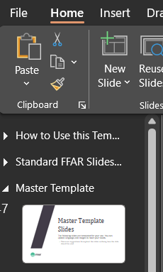
Template Sections
This deck contains three sections:
  Using this template
  Standard FFAR slides
  Master template
Each section details how to use the slides within it. You can view or collapse the slides in each section in the left-hand banner by clicking the triangle at the left of each section.

Slide 6
Preparing Your Presentation
When preparing your presentation, consider:
  Who is the audience?
  What is the main point you want to convey?
  What is the format (in-person, virtual, panel, Q&A, etc.)?
  How much time do you have to present?
Build a message box (with your CommsLeg POC) before developing slides.
  DO NOT include the message box in your final presentation.
Discuss presentation logistics with your CommsLeg POC.
  Will you be advancing your slides or will someone else?
  Will you be able to see the screen with your presentation or is it behind you?
  Is there a screen to see your notes or do you need to print them?
  Remember to build in time for a practice session with you CommsLeg POC

Slide 7
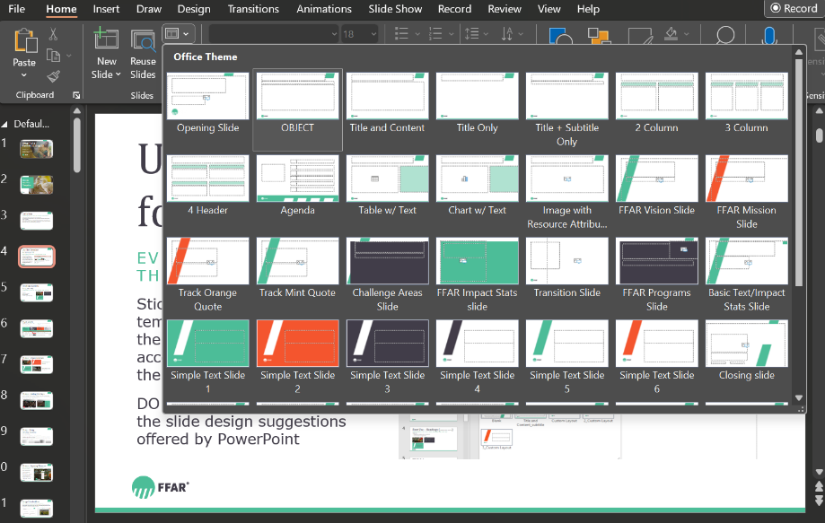
Use This Template for Every PPT
All branding elements are in this template
Stick to the branded slide templates programmed into the Layout function. You can access the layout drop-down menu on the Home tab.
DO NOT use the Design tab or the slide design suggestions PPT offers.
Access slide Layout options using this drop-down menu

Slide 8

Fonts & Sizes
Headings (Cambria font, size 60)
SUBHEADINGS (TEXT IS ALL CAPS, VERDANA FONT, SIZE 20)
Body text (Verdana font, size 20)
  First level bullets (Verdana, size 18)
    Second level bullets (Verdana, size 16)
      Third level bullets (Verdana, size 14)
All text is aligned left, always. DO NOT center text.

Slide 9
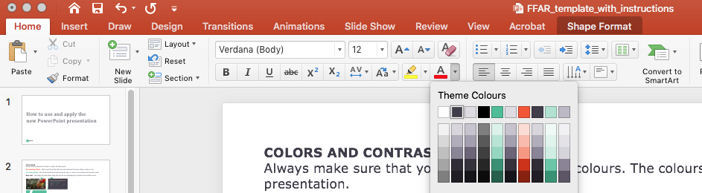

FFAR Colors
  All colors are pre-set in this template
  Always use FFAR’s brand colors.
  Hyperlinks are orange.
  All text is Dark Gray, Green or White. DO NOT use black.
  Avoid using the Green and Orange together.
The colors are pre-set Theme Colors from the drop-down menu, including colors for text, shapes and bullets.
GREEN
CMYK 66 / 0 / 53/ 0
RGB 76/ 189 / 152
HEX #4cbd98
PMS 338U / 2413C
DARK GREY
CMYK 71 / 68 / 51 / 42
RGB 65 / 61 / 73
HEX #413d49
PMS 533U / 2379C
BRIGHT ORANGE
CMYK 0 / 82/ 91 / 0
RGB 244 / 85 / 46
HEX #f4552e
PMS 2026U / 2026C
LIGHT GREY
CMYK 11 / 10 / 6 / 0
RGB 222 / 220 / 226
HEX #dedce2
PMS 5313U / 5313C

Slide 10




Adding Branded Bullets
Bullets should be branded as follows, not gray
To add branded bullets:
  On a blank line, click the Increase List Level button( ) in the ribbon above.
    DO NOT click the Bullets button ( ). This will lose the branded bullet formatting.
  Your bullet should then appear with the FFAR green color.
    Then hit the Tab key on your keyboard or click the Increase List Level button from the ribbon above to increase to level 2.
      Hit Tab or click Increase List Level once more to indent to increase level 3.
    Hit the Shift and Tab keys (PC only) on your keyboard at the same time or click the Decrease List Level ( ) to decrease the list level.

Slide 11

Logo Usage
All slides must include the FFAR Logo.
When using the FFAR logo in PowerPoint, only use the “FFAR + Icon logo” option. This logo is the circle and the acronym FFAR and is available on the branding page. The FFAR logo is already included on all slides in this template.

Slide 12
Photos & Images
Use high-quality images to tell your story
A picture is more engaging than text.
  Use high-quality, royalty-free and license-free images.
    Image theft, using an image without express permission, is illegal and violates copyright laws.
  Your CommsLeg POC can provide appropriate images.
    The CommsLeg Team stores all approved legal imagery in the Stock Photos folder in SharePoint.
  Reference the FFAR branding page for photography use and guidelines.
To improve accessibility, DO NOT place text over images when creating new slides.
  The Standard FFAR Slides have text over images and were designed specifically to be accessible. Staff should not edit these slides.
  Staff are welcome to change the images on the Opening and Closing slides.
    Reach out to your CommsLeg Team if you need assistance changing images.

Slide 13
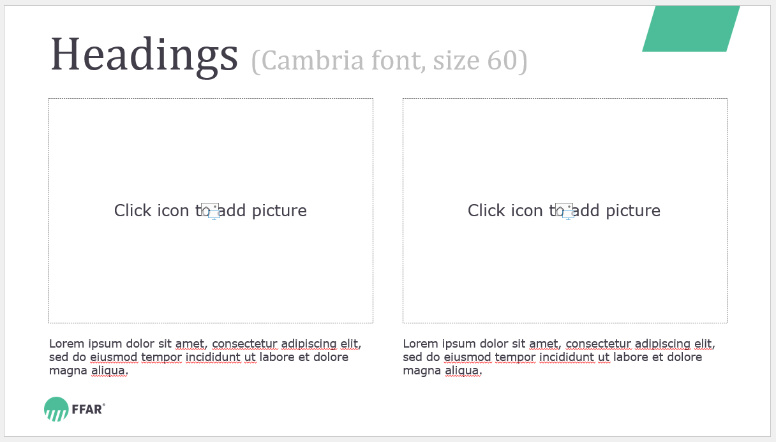
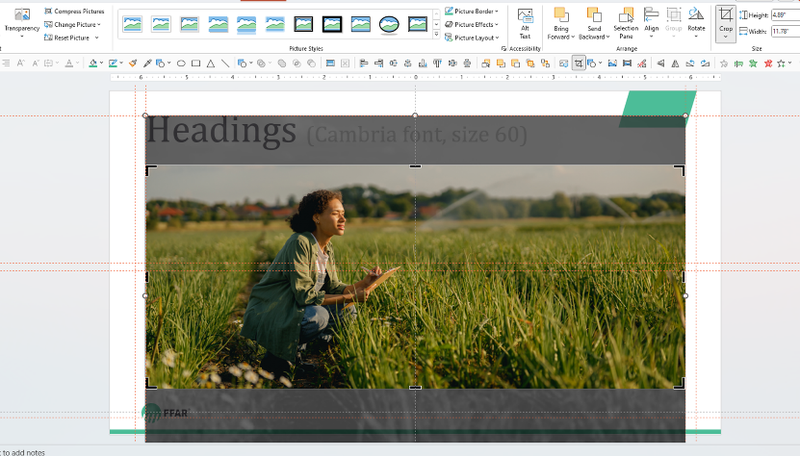
Adding Images
how to use & adjust image placeholders
Click the image icon to add a picture—do not copy and paste an image. Use the Picture Format tab to adjust the photo and click the Crop icon. Click and drag the picture within the placeholder to reposition the image if necessary.

Slide 14

Create Color Contrast
      DO NOT use dark text on a dark background or
light text on a light background.
      Instead choose text colors that create contrast against the background.

Slide 15
Use Icons Judiciously
GUIDE TO USING ICONS
Icons can effectively explain concepts visually and engage the viewer.
  Download icons for your PowerPoint presentations from The Noun Project. The login information is:
    Username: communications@foundationfar.org
    Password: Whitten536A!
  All icons must use FFAR branded colors. DO NOT use black. Color codes can be found on the branding page and slide 9: FFAR Colors.
  Icons should be in line and all the same size.
DO NOT use the Insert an Icon feature that is directly available in PowerPoint.

Slide 16
If You Must Include Lots of Text
THIS SLIDE IS FOR YOU
The CommsLeg Team strongly encourages you to talk through presentations and use PowerPoints for images, photos and graphs.
  Slides should include topline messages, not everything you want to say. Instead, use the Notes section below to plan your talking points.
Use this slide sparingly in your presentations.
  Consider using animations to drop in the bullets as you discuss them. Here’s how:
    Click Animations in the top menu bar.
    Highlight the text you want to appear on the slide as you speak.
    Click Appear from the Animations options.
    Reorder your animations by clicking the orange number displayed next to the animated bullet.
      Click Move Earlier or Move Later under Reorder Animation at the top right of the menu bar.

Slide 17
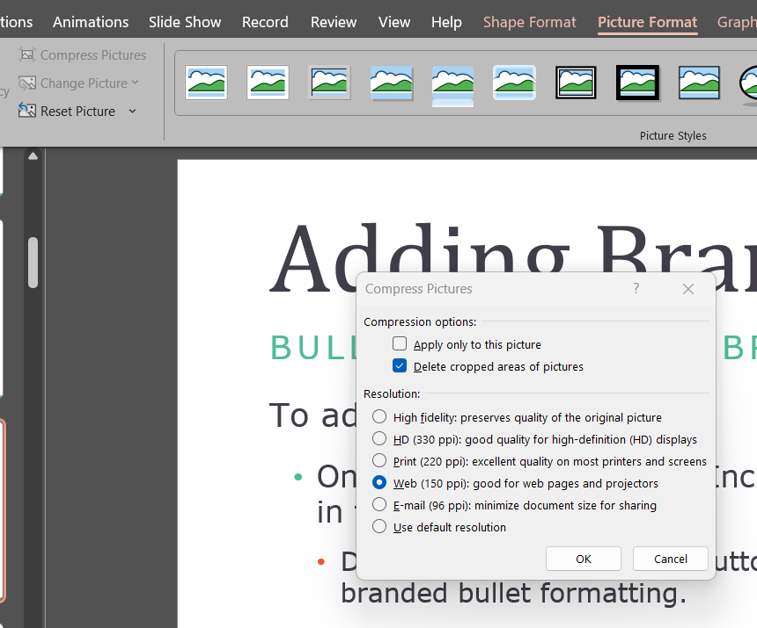
Compressing Photos, PC
On a PC
To decrease the MB size of your PPT file:
Open your PowerPoint file on your desktop.
Select a slide that contains an image.
Select the image.
Click Picture Format from the ribbon above.
Click Compress Pictures.
Check Delete cropped areas of pictures.
Uncheck Apply only to this picture.
Choose Web (150 ppi).
Click OK.

Slide 18

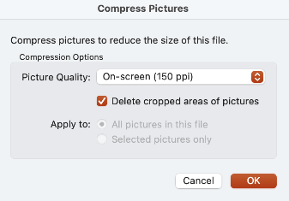
Compressing Photos, Mac
On a MAc
To decrease the MB size of your PPT file:
Open your PowerPoint file on your desktop.
Click the File tab in the upper left-hand corner.
Select Compress Pictures from the dropdown.
Select On Screen (150 ppi).
Check Delete cropped area of pictures.
Check apply to: All pictures in this file.
Click OK.

Slide 19
Sharing Your Deck
Ways to share your slide deck
  Save and share link directly from Box when sharing your deck internally with colleagues.
  Compress and email as an attachment when sharing your deck externally.
    Compressing the photos will allow you to email your deck as attachment.
  If necessary, save and share your deck as a PPT file via a link from Hightail, a secure external file sharing cloud service.
    Login: Communications@foundationfar.org; Password: Lns1FB14skf!

Slide 20
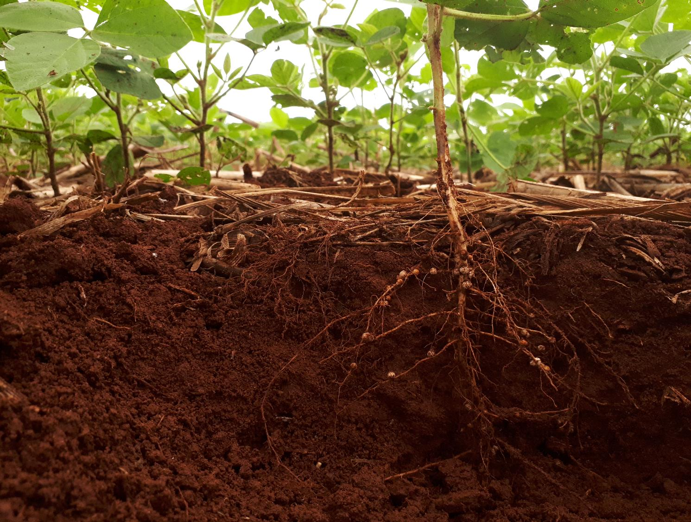
Standard FFAR Slides

Slide 21
Standard FFAR Slides
The following slides should be used to:
  Introduce FFAR
  Describe our unique funding model
  Provide a high-level overview of our grants and partners
  Highlight our Priority Areas and Consortia
DO NOT edit the slides in this section. Should the slides require updating, notify the CommsLeg Team.

Slide 22


About FFAR
FFAR, established in 2014 by the Farm Bill, connects funders, researchers and farmers to pioneer the next frontier of agriculture innovation.

Slide 23

Our Mission
We build collaborative partnerships to support audacious science addressing today’s food and agriculture challenges.

Slide 24

Our Vision
We envision a world in which pioneering, collaborative science provides every person access to affordable, nutritious food grown on thriving farms.

Slide 25




Funding Mechanisms
FFAR’s public-private partnerships advance food and agriculture research through four funding mechanisms:
Competitive Grants
Direct Awards
Prizes
Consortia

Slide 26
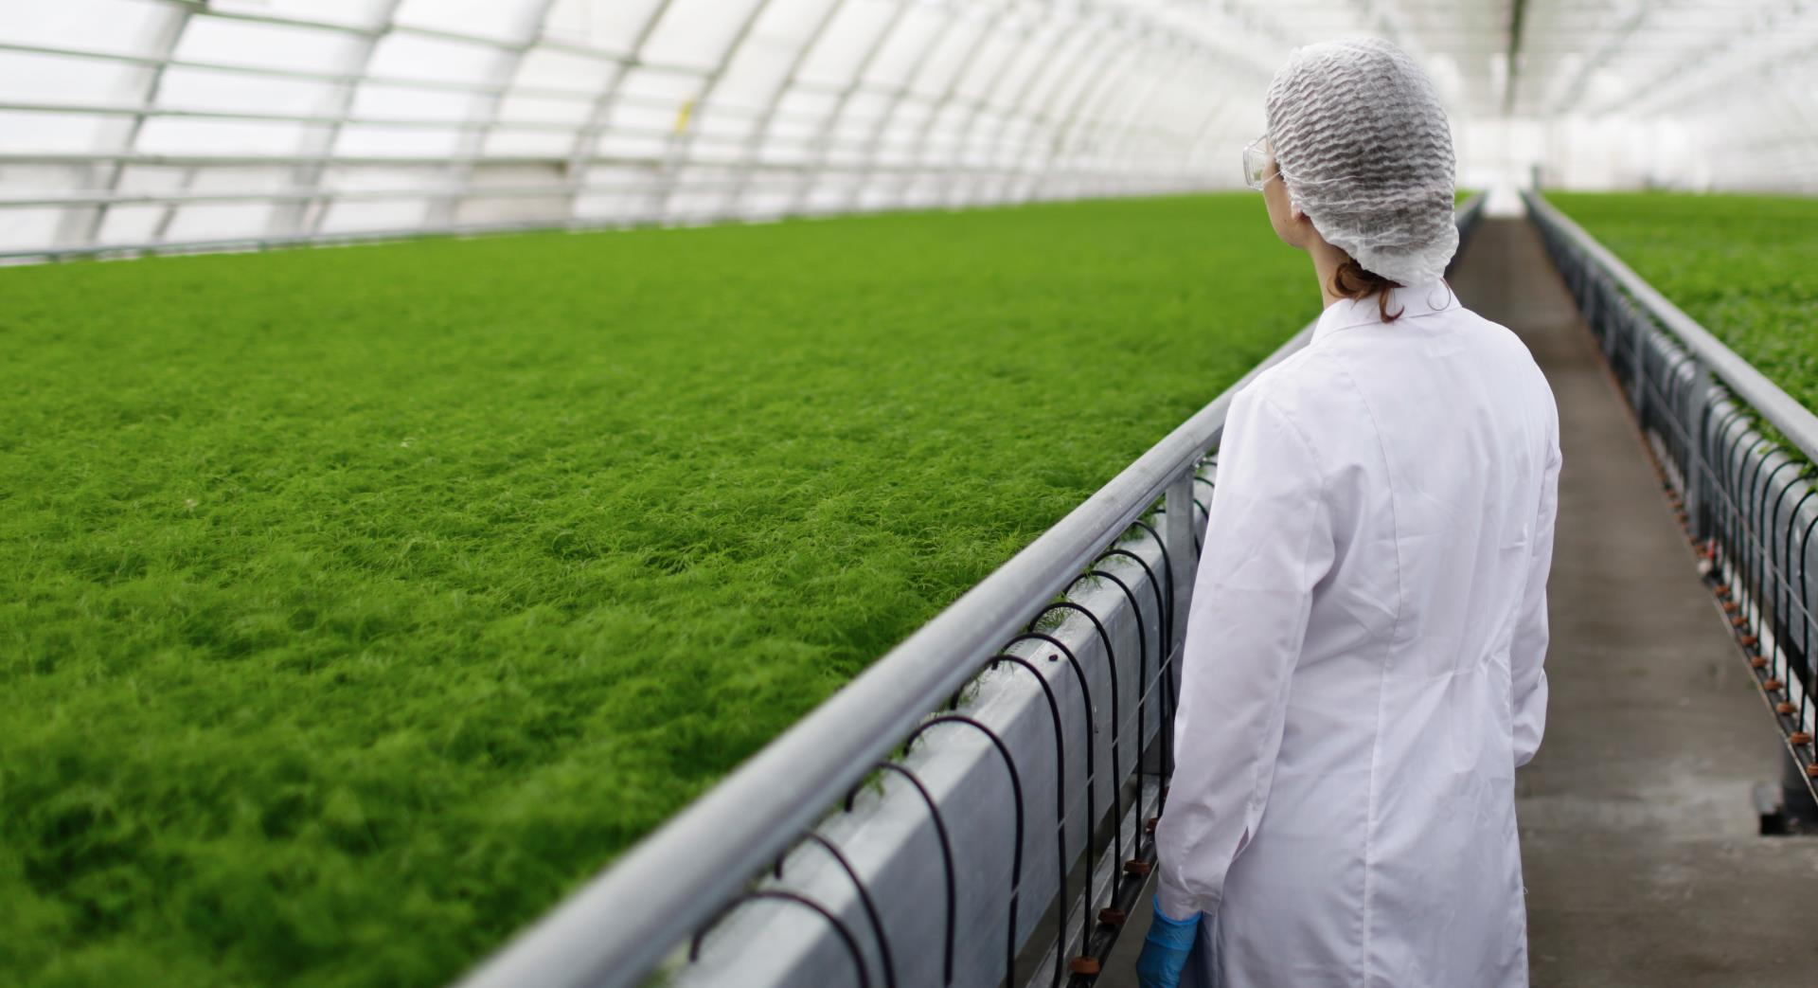
Research Benefits U.S. Economy
U.S. Department of Agriculture’s (USDA) Economic Research Service (ERS) found:
Public agricultural research investments generate $20 in U.S. economic benefits for every $1 spent.
Source: www.ers.usda.gov/amber-waves/2022/june/ investment-in-u-s-public-agricultural-research-and-development-has-fallen-by-a-third-over-past-two-decades-lags-major-trade-competitors/

Slide 27

The FFAR Factor
FFAR’s Research:
  Complements USDA’s research agenda
  Fills critical knowledge gaps
  Increases public agriculture research investments
  Focuses on actionable science
  Involves farmers to solve current challenges
  Moves research from the lab and into the field

Slide 28
FFAR’s Unique Model
HOW WE DIFFER FROM OTHER RESEARCH GRANTING AGENCIES
Amplify Funding
FFAR's model multiplies the U.S. public
Private Sector Collaborations
Knowledge and solutions reach
Build Consortia
De-risks research, brings multiple funding partners
Deploys rapid
Rapid Response Funding
response funding to address emerging pests and diseases
research investment
end-users
Notes:
FFAR’s model has more than doubled Congress’s investment even as public food and agriculture research investment has declined by over a third in the last 25 years.
Public-private partnerships are central to the FFAR model.
These partnerships amplify federal investment in food and agriculture research.
Our partnerships with industry, farmers and other key stakeholders further inform our programming, ensuring FFAR research addresses urgent, real-world problems.
FFAR builds consortia with multiple funding partners. These partnerships de-risk research and lower the cost for participants individually, allowing them to collaborate with competitors and other sections of the supply chain impacting their operations both upstream and downstream.
FFAR funds research in response to unanticipated pests and pathogens, advancing innovative, high-risk projects quickly.
FFAR can award a rapid-response research grant just 2-3 months after a proposal is received, considerably faster than most federal agencies.
The Foundation’s rapid response grants aim to fill urgent research gaps until traditional, longer-term funding can be secured

Slide 29
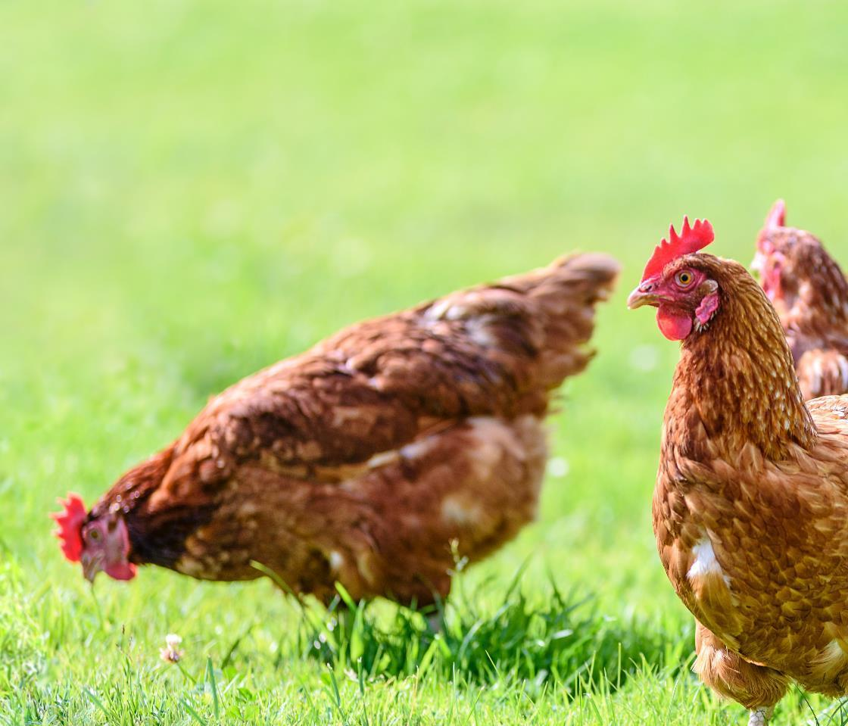
FFAR's Impact
400+
GRANTS AWARDED
$1:$1.40
MATCHING RATIO
550+
PARTNERS
$775M
FUNDING AWARDED
Notes:
FFAR has over 550 distinctive funding partners various sectors including academia, commodity boards, foundations, industry and nonprofits.

Slide 30
We Fund Pioneering Research
BY FOCUSING ON THESE PRIORITY AREAS:
  Cultivating Thriving Production Systems
  Bolstering Healthy Food Systems
  Sustaining Vibrant Agroecosystems
  Strengthening the Scientific Workforce

Slide 31

Cultivating Thriving Production Systems
Our Production Systems research supports animal and crop systems to increase productivity, combat pest and disease threats, support animal welfare and safeguard farmers’ livelihoods.

Slide 32
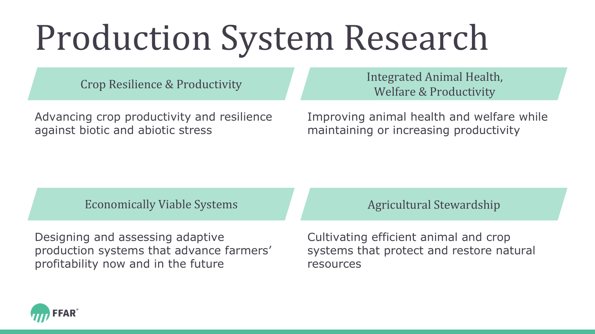
Production System Research
Crop Resilience & Productivity
Integrated Animal Health, Welfare & Productivity
Advancing crop productivity and resilience against biotic and abiotic stress
Improving animal health and welfare while maintaining or increasing productivity
Economically Viable Systems
Agricultural Stewardship
Designing and assessing adaptive production systems that advance farmers’ profitability now and, in the future
Cultivating efficient animal and crop systems that protect and restore natural resources

Slide 33

Sustaining Vibrant Agroecosystems
Our Agroecosystems research deepens our understanding of how agriculture systems interact with the surrounding environment to help farmers optimize resource use and enhance productivity.

Slide 34
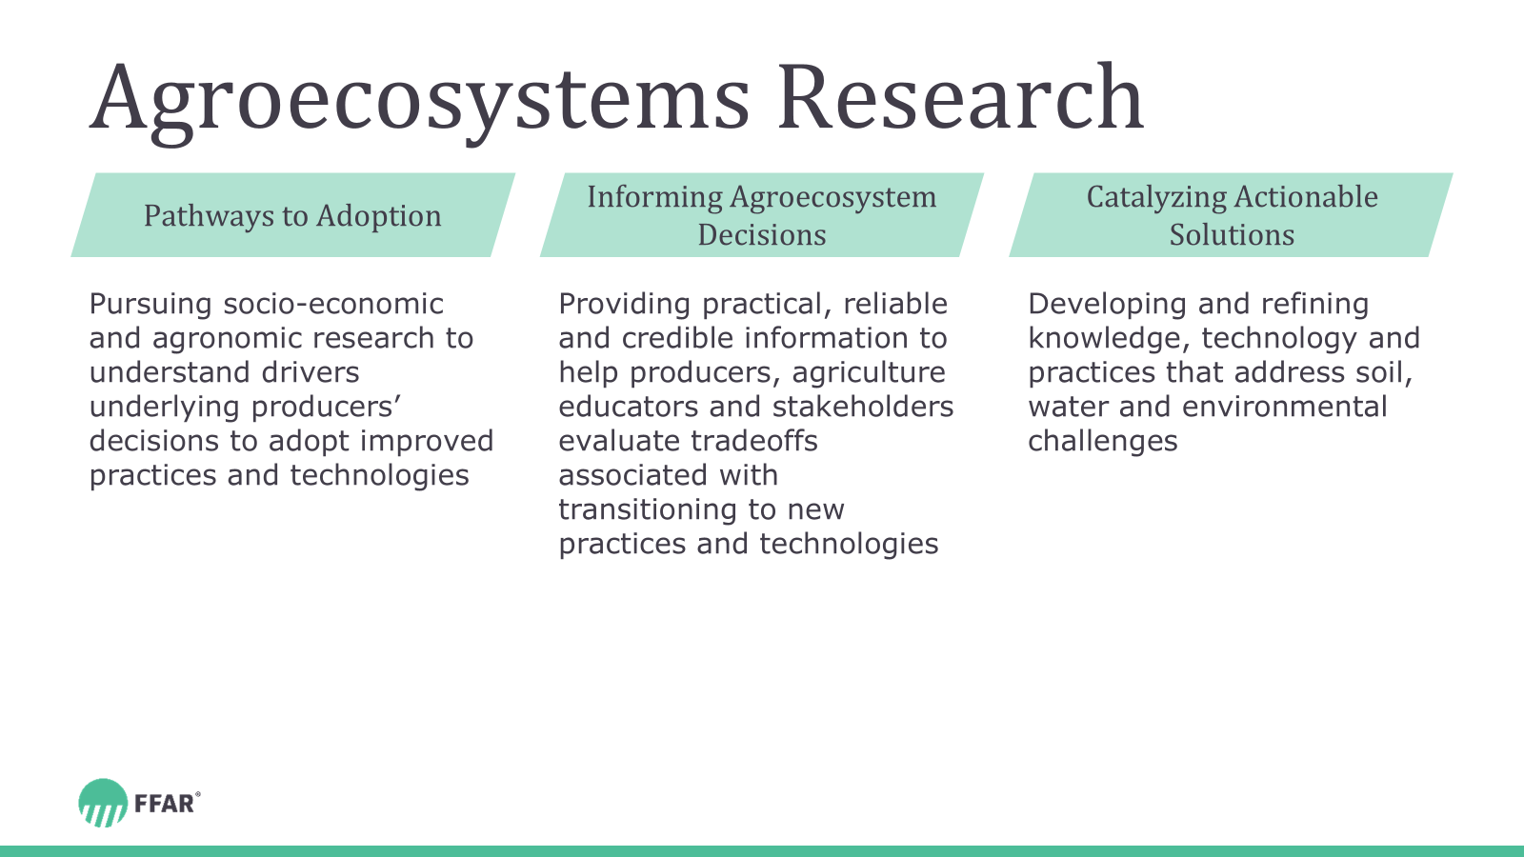
Agroecosystems Research
Pathways to Adoption
Informing Agroecosystem Decisions
Catalyzing Actionable Solutions
Pursuing socio-economic and agronomic research to understand drivers underlying producers’ decisions to adopt improved practices and technologies
Providing practical, reliable and credible information to help producers, agriculture educators and stakeholders evaluate tradeoffs associated with transitioning to new practices and technologies
Developing and refining knowledge, technology and practices that address soil, water and environmental challenges.

Slide 35

Bolstering Healthy Food Systems
Our Food Systems research promotes the availability of nutritious foods, improves human health, develops novel food processes and products and advances the U.S. food system’s functionality.

Slide 36
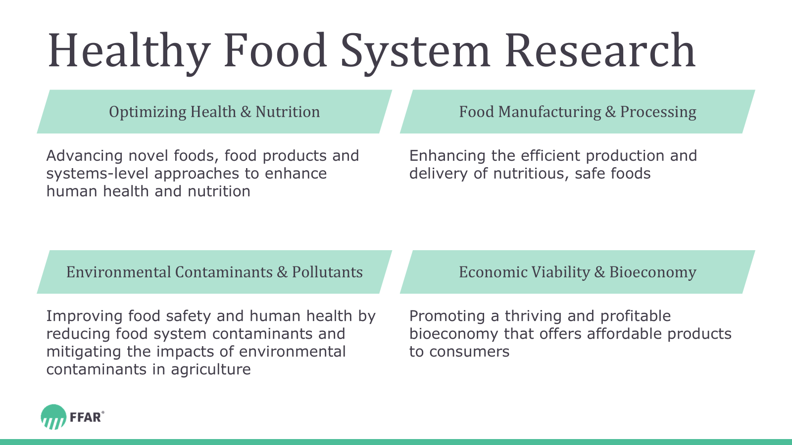
Healthy Food System Research
Optimizing Health & Nutrition
Food Manufacturing & Processing
Advancing novel foods, food products and systems-level approaches to enhance human health and nutrition
Enhancing the efficient production and delivery of nutritious, safe foods
Environmental Contaminants & Pollutants
Economic Viability & Bioeconomy
Improving food safety and human health by reducing food system contaminants and mitigating the impacts of environmental contaminants in agriculture
Promoting a thriving and profitable bioeconomy that offers affordable products to consumers

Slide 37
Strengthening the Scientific Workforce
Our Scientific Workforce programs continue our longstanding commitment to address critical shortages in research and scientific workforce training.

Slide 38

We Strengthen the Scientific Workforce
BY FOSTERING THESE PROGRAMS:
FFAR Fellows
New Innovators in Food and Agriculture
NAS Prize in
Agriculture Science
Veterinary Student Research Fellows
OCP Disruptive Fertilizer Technology Fellowship
Nature-Based
Solutions

Slide 39

Scientific Workforce Themes
Exploring Adjacent Talent Pools
Attracting New Talent
Retaining Existing Talent
Exploring opportunities to expand the food and agriculture workforce by attracting relevant talent from adjacent and non-traditional disciplines
Identifying gaps in the agricultural scientific workforce and developing strategies for attracting new food and agriculture researchers
Incentivizing career-long engagement in food and agriculture research

Slide 40






FFAR Consortia
Our consortia unite partners to achieve a shared goal.

Slide 41
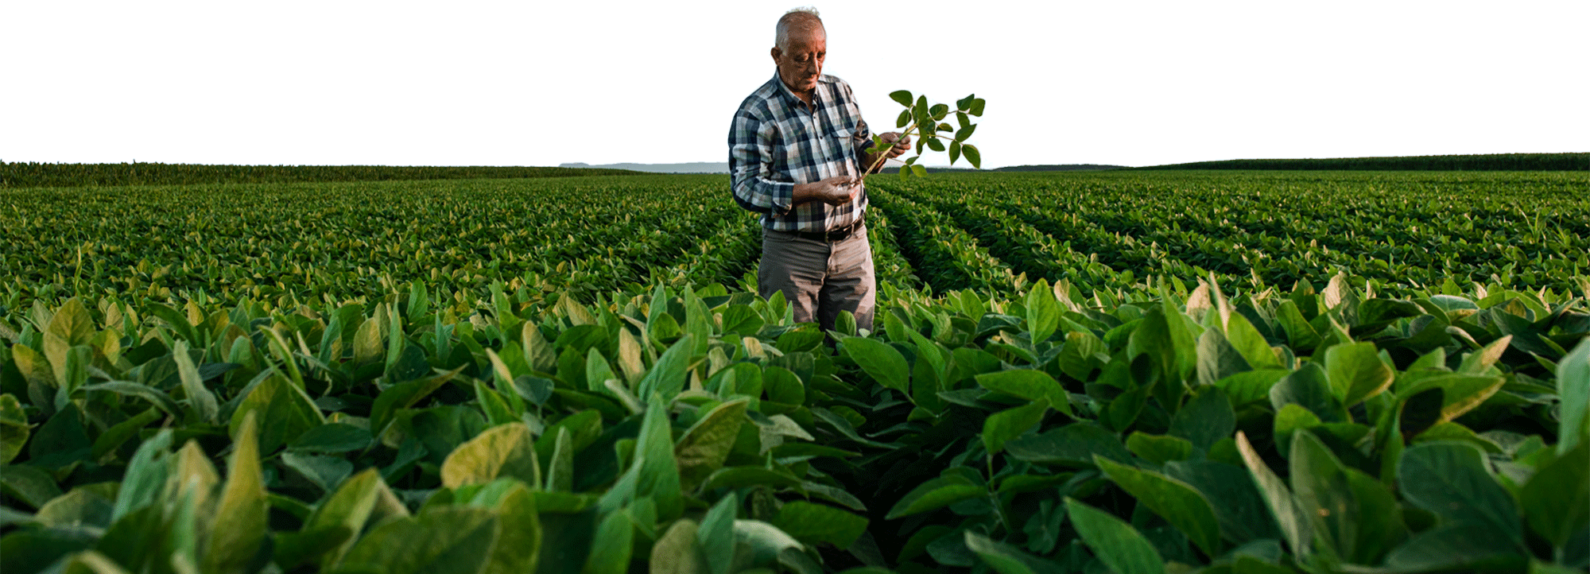



AgMission™
Together, FFAR and World Farmers' Organisation established AgMission, an initiative that unites farmers, ranchers and scientists to validate and accelerate scalable, locally customized solutions.

Slide 42
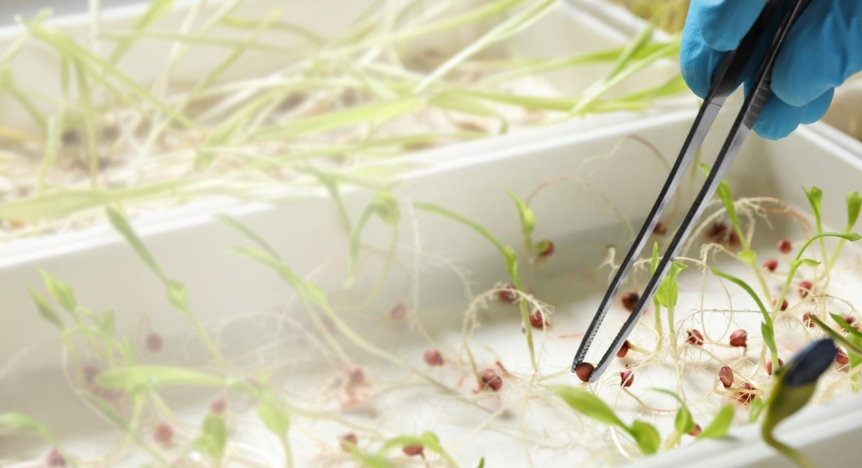

Crops of the Future
Crops of the Future (COTF), a public-private collaborative, expands knowledge of traits that give rise to characteristics crops need to adapt to a changing future.

Slide 43


Efficient Fertilizer Consortium
The Efficient Fertilizer Consortium is a public-private partnership that funds research to advance enhanced efficiency and novel fertilizer products and practices that improve crop production and decrease environmental impact.

Slide 44
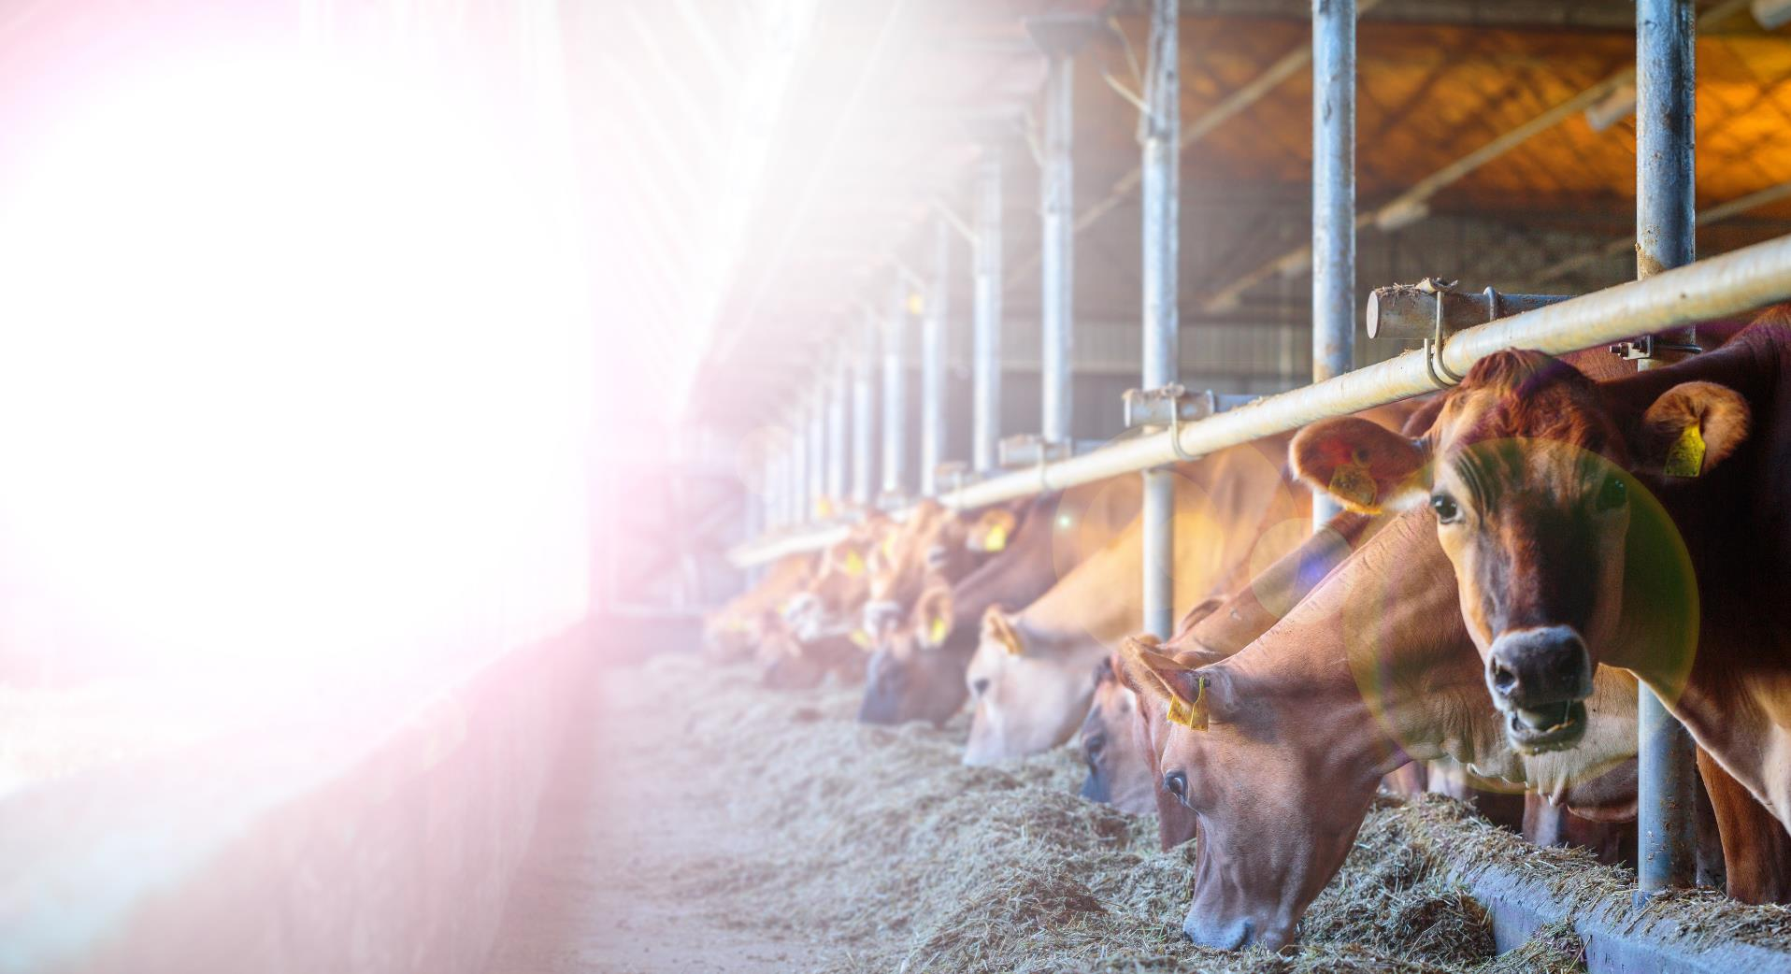

Greener Cattle Initiative
The Greener Cattle Initiative (GCI) is an industry-oriented consortium that supports research to mitigate enteric methane emissions from cattle.

Slide 45
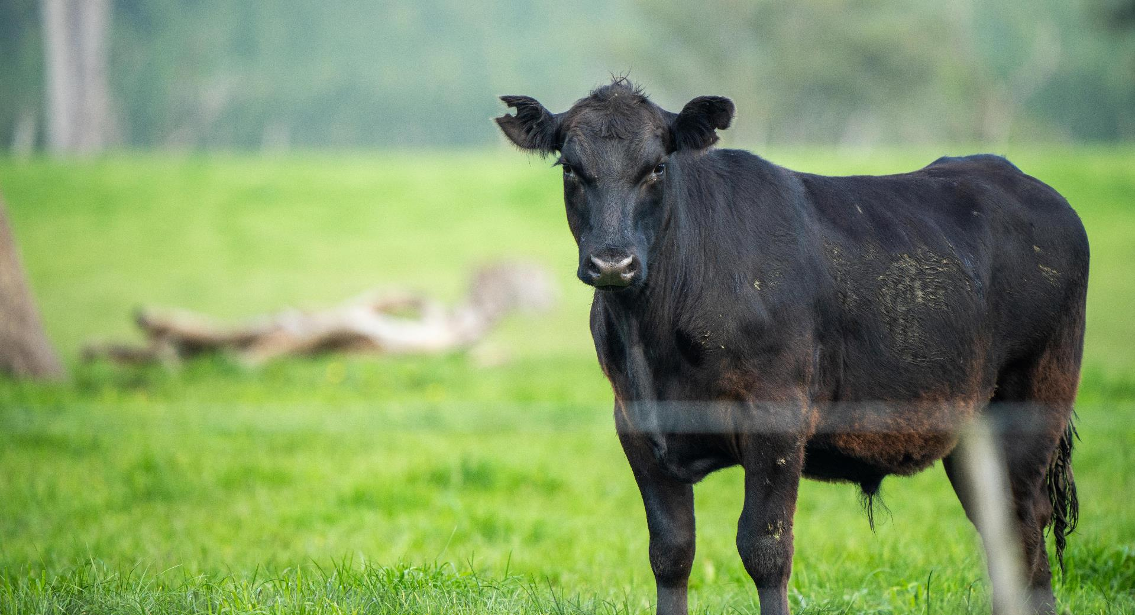

ICASA
The International Consortium for Antimicrobial Stewardship in Agriculture (ICASA) pioneers technologies and management practices that promote judicious antibiotics use to produce healthier livestock

Slide 46


Precision Indoor
Plants
The Precision Indoor Plants (PIP) consortium conducts research to grow flavorful, nutritious food indoors and increase our ability to produce valuable, quality crops.

Slide 47



FFAR Membership in Consortia
FFAR is a member of several consortia, which are managed by other organizations.

Slide 48
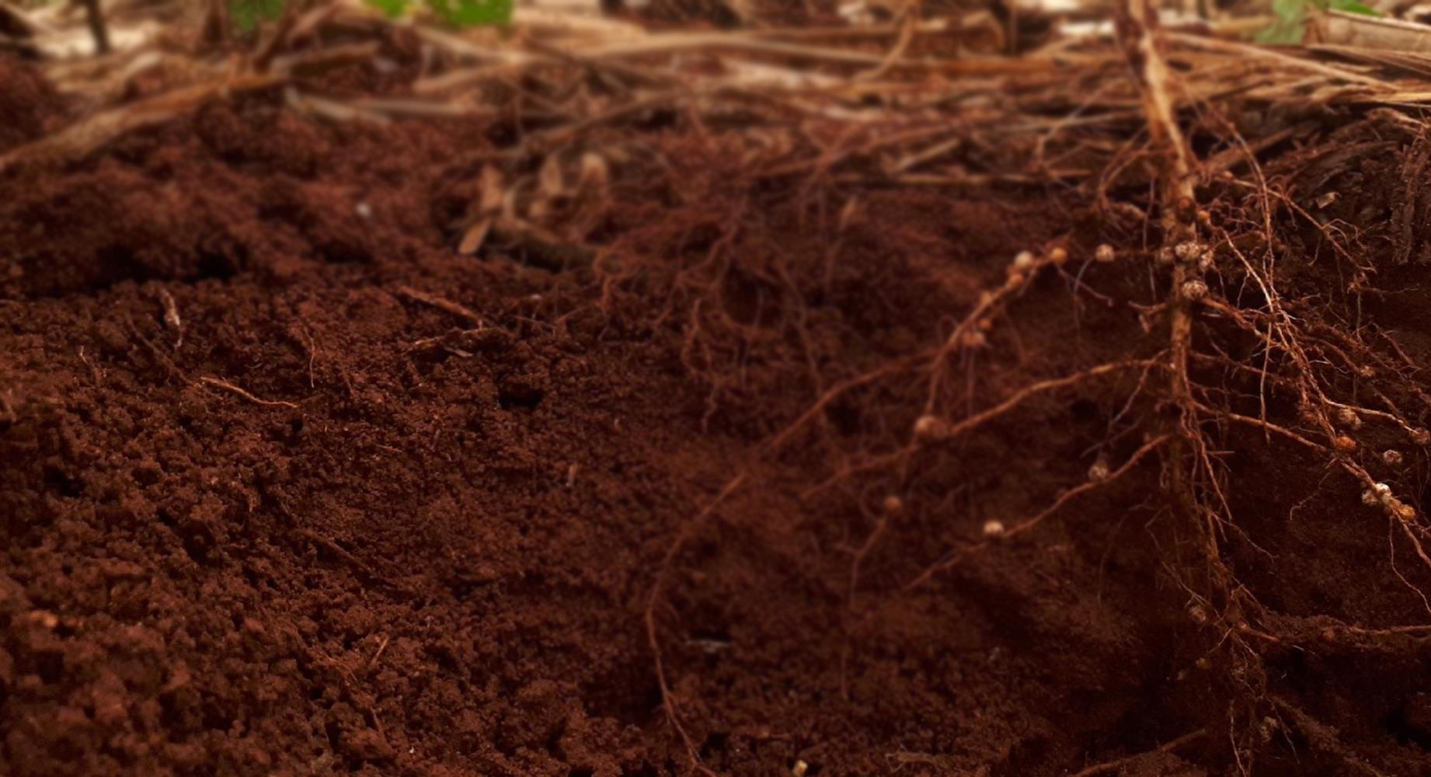

Ecosystem Services Market Consortium
The Ecosystem Services Market Consortium (ESMC) is a nonprofit organization that compensates farmers and ranchers who adopt agriculture practices that improve the environment. FFAR partners with ESMC to fund consortium research that is needed to create a national ecosystem services market that benefits producers, local communities, supply chain companies and consumers.

Slide 49


Hemp Research Consortium
The Hemp Research Consortium supports optimizing industrial hemp production.

Slide 50



Innovation in
Post-Harvest Loss & Food Waste Reduction Consortium
The Innovation in Post-Harvest Loss & Food Waste Reduction Consortium conducts research to prevent food and nutrient loss and waste and promote food security.

Slide 51
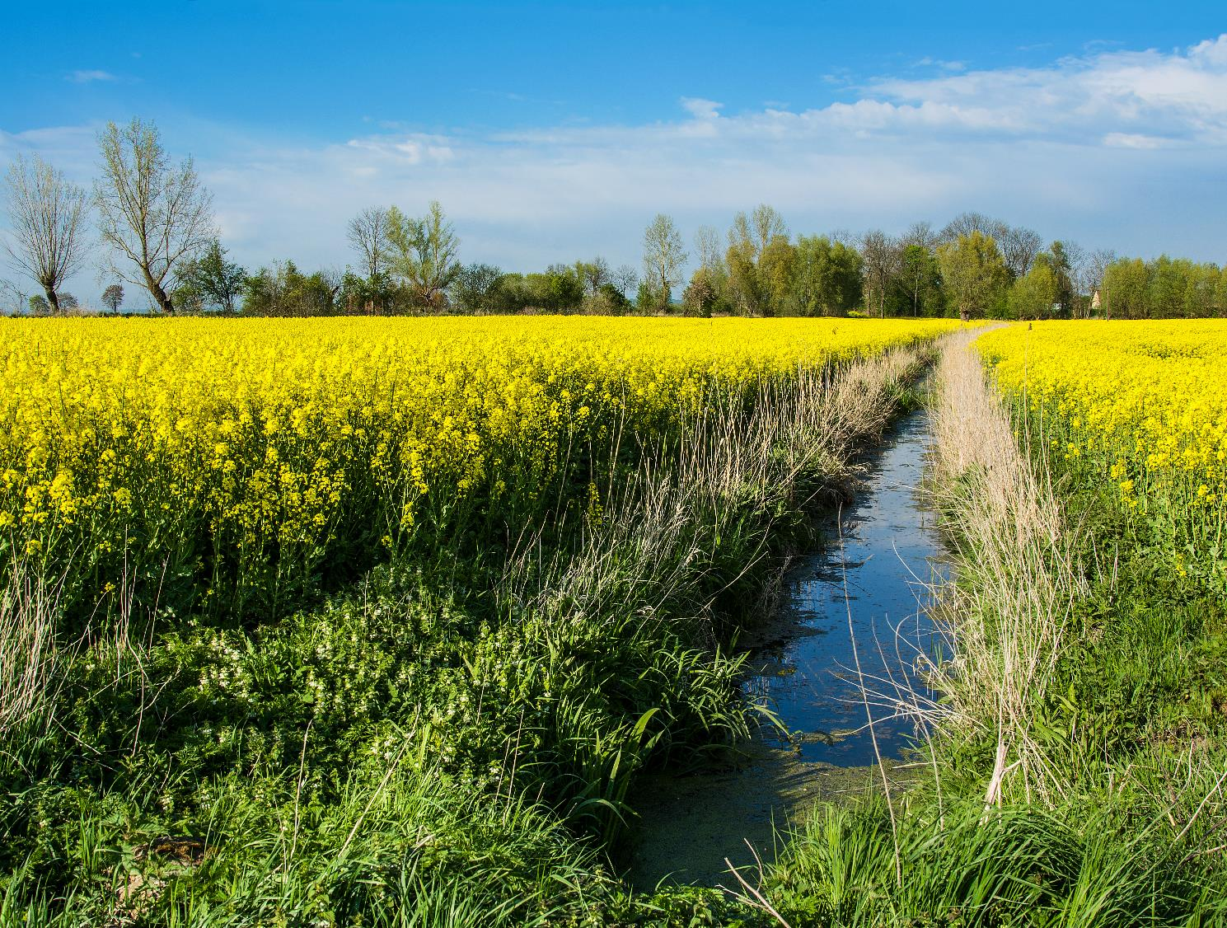
Master Template

Slide 52
Master Template Slides
The following slide templates are designed for your use. Please update language and images to meet your needs.
  DO NOT use the placeholder images, except for the Opening and Closing slides.
  We’ve included suggestions for best practices throughout these slides.

Slide 53

Opening Slide
General Option
MONTH XX, YEAR
(ex: APRIL 11, 2025)
Presenter Name (if relevant)
Location (if relevant)

Slide 54
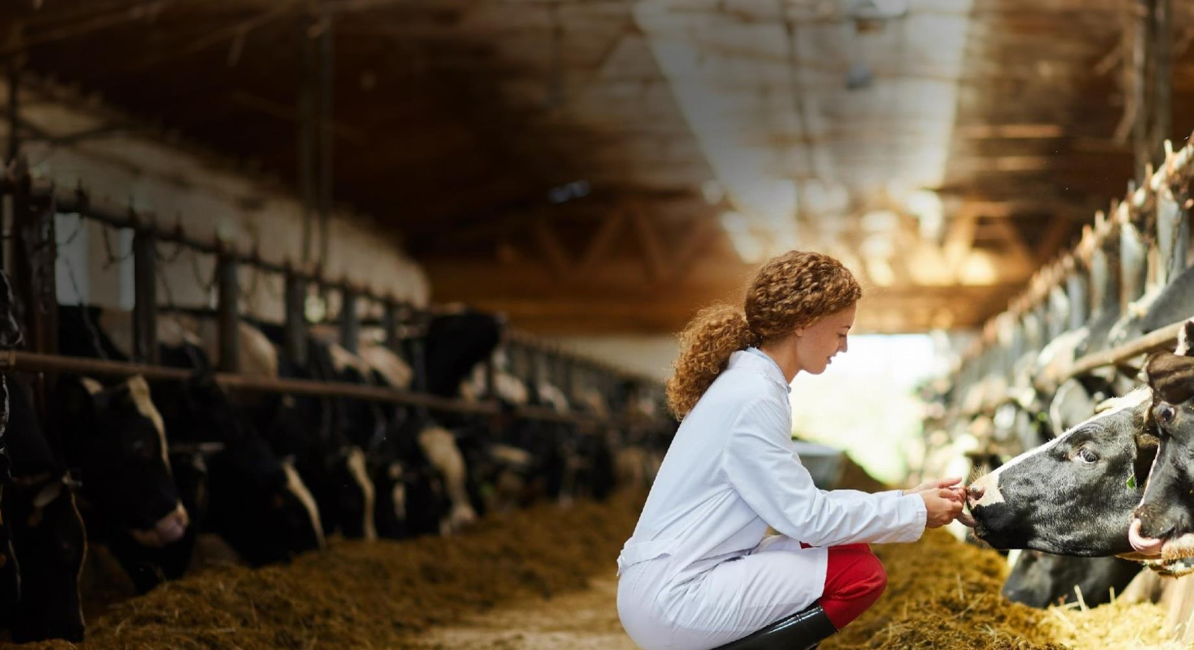
Cultivating Thriving Production Systems
MONTH XX, 2025
Presenter Name (if relevant)
Location (if relevant)

Slide 55
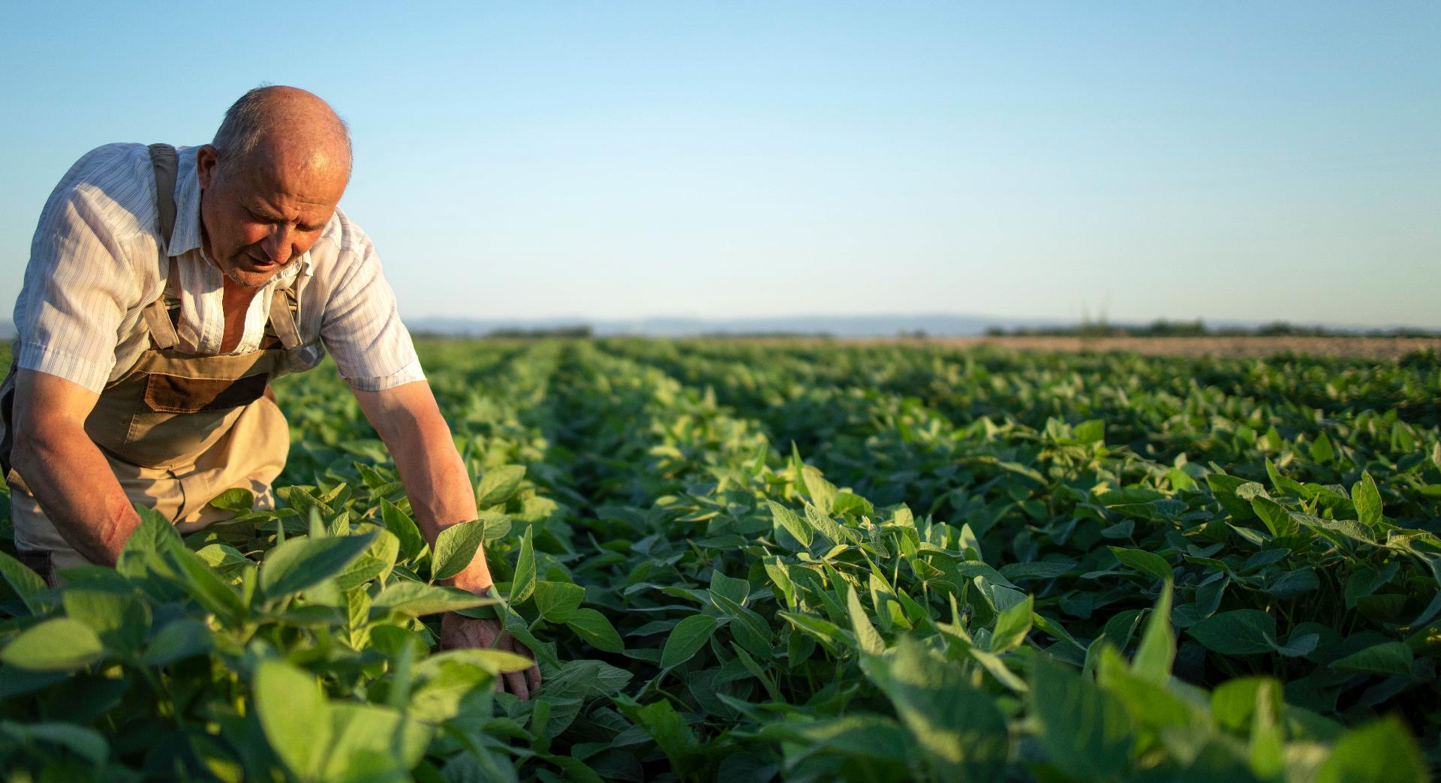
Cultivating Thriving Production Systems
MONTH XX, 2025
Presenter Name (if relevant)
Location (if relevant)

Slide 56

Sustaining Vibrant Agroecosystems
MONTH XX, YEAR
Presenter Name (if relevant)
Location (if relevant)

Slide 57

Bolstering Healthy Food Systems
MONTH XX, YEAR
Presenter Name (if relevant)
Location (if relevant)

Slide 58

Strengthening the Scientific Workforce
MONTH XX, YEAR
Presenter Name (if relevant)
Location (if relevant)

Slide 59
Agenda
01
Welcome & Introduction
02
About FFAR
03
Partnership Highlights
04
Research & Impacts
05
Open Opportunities
06
Closing

Slide 60

“Use this slide when you want to highlight a quote or quick fact.”
JOHN SMITH, Sample company
Do not allow the text to pass the horizon and overlay the greenery.

Slide 61
Simple Text
This slide is for simple, brief text. Keep your text concise. For text longer than what is seen here, consider using the “Large Text Box” slide.
DO NOT move the title or text box. DO NOT place text or images on top of the FFAR Track.
You may expand the length of this text box to fill the space from here to the bottom of the slide
  Consider basic bullets

Slide 62

Simple Text
This slide is for simple, brief text. Keep your text concise. For text longer than what is seen here, consider using the “Large Text Box” slide.
DO NOT move the title or text box. DO NOT place text or images on top of the FFAR Track.
You may expand the length of this text box to fill the space from here to the bottom of the slide
  Consider basic bullets

Slide 63
Simple Text
This slide is for simple, brief text. Keep your text concise. For text longer than what is seen here, consider using the “Large Text Box” slide.
DO NOT move the title or text box. DO NOT place text or images on top of the FFAR Track.
You may expand the length of this text box to fill the space from here to the bottom of the slide
  Consider basic bullets

Slide 64
Simple Text
This slide is for simple, brief text. Keep your text concise. For text longer than what is seen here, consider using the “Large Text Box” slide.
DO NOT move the title or text box. DO NOT place text or images on top of the FFAR Track.
You may expand the length of this text box to fill the space from here to the bottom of the slide
  Consider basic bullets

Slide 65
Simple Text
This slide is for simple, brief text. Keep your text concise. For text longer than what is seen here, consider using the “Large Text Box” slide.
DO NOT move the title or text box. DO NOT place text or images on top of the FFAR Track.
You may expand the length of this text box to fill the space from here to the bottom of the slide
  Consider basic bullets

Slide 66
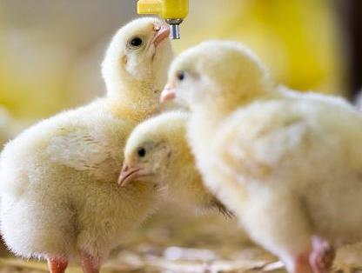
Transition Slide
(Use this slide to introduce a new topic.)

Slide 67

Transition Slide
(Use this slide to introduce a new topic.)

Slide 68

Transition Slide
(Use this slide to introduce a new topic.)

Slide 69
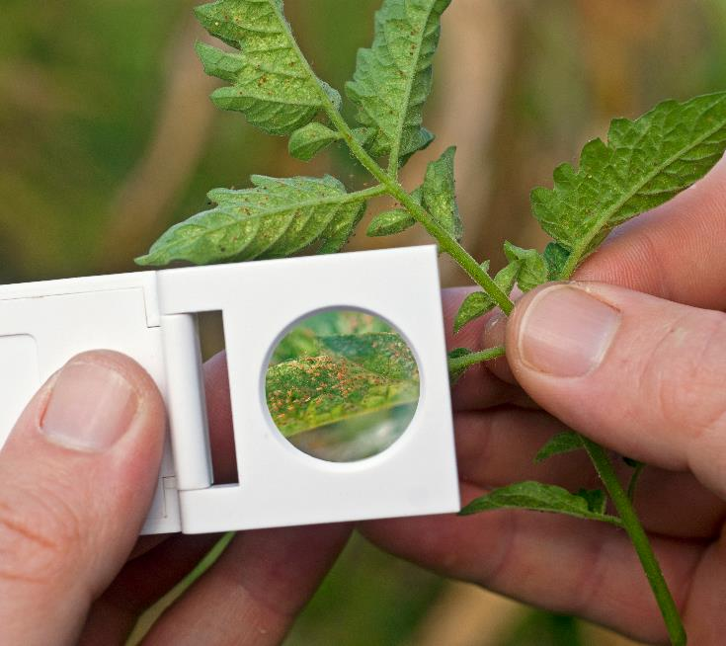
Image Slide (Cambria font, size 60)

Slide 70

Image Slide (Cambria font, size 60)

Slide 71
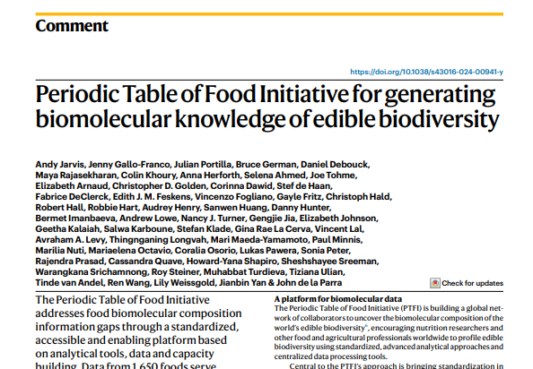

Images Slide (Cambria font, size 60)
Source: Nature; Jarvis, A., Gallo-Franco, J., Portilla, J. et al. Periodic Table of Food Initiative for generating biomolecular knowledge of edible biodiversity. Nat Food 5, 189–193 (2024). https://doi.org/10.1038/s43016-024-00941-y
Fontoura, A., Javaid, A., Sáinz de la Maza-Escolà, V., Salandy, N., Fubini, S., Grilli, E., & McFadden, J. (2022). Heat stress develops with increased total-tract gut permeability, and dietary organic acid and pure botanical supplementation partly restores lactation performance in Holstein dairy cows. Journal of Dairy Science, 105(9), 7842-7860. https://doi.org/10.3168/jds.2022-21820

Slide 72



Images Slide (Cambria font, size 60)
Briefly describe what you want your audience to glean from the image. Provide attribute, when needed.

Slide 73
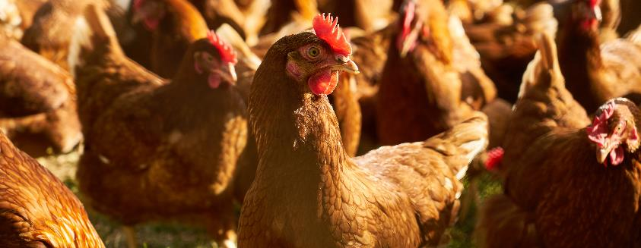


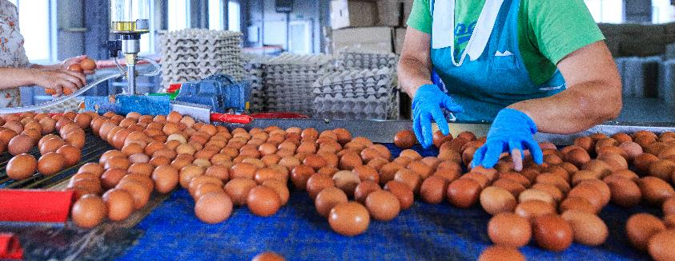
Images Slide (Cambria font, size 60)

Slide 74
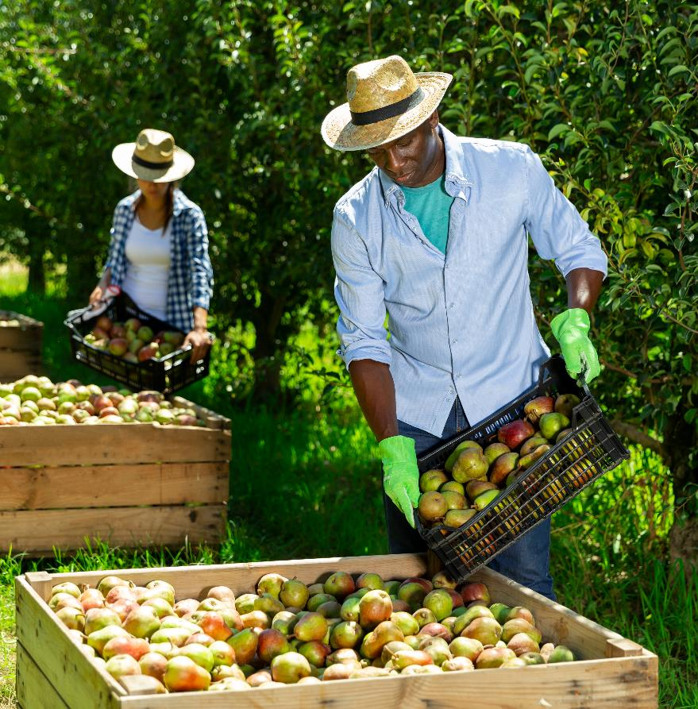
Image with Content
This slide is for simple text with one picture.
  DO NOT move the title or text box.
  DO NOT place text on top of image.
  You may expand the length of this text box to fill the space from here to the bottom of the slide.

Slide 75

Image with Content
This slide is for simple text with one picture.
  DO NOT move the title or text box.
  DO NOT place text on top of image.
  You may expand the length of this text box to fill the space from here to the bottom of the slide.

Slide 76

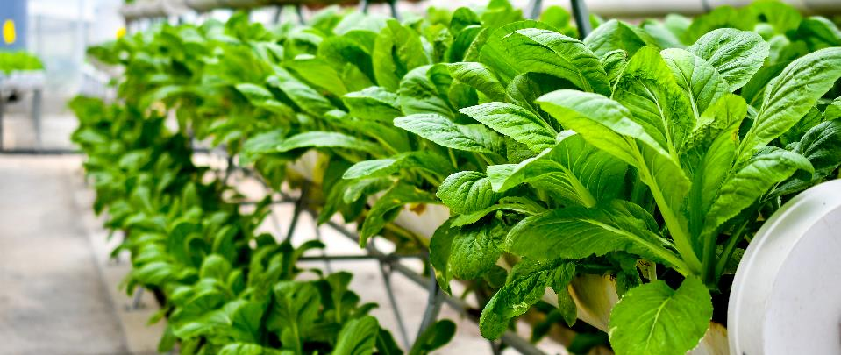
Two Images with Content
This slide is for simple text with two pictures.
  DO NOT move the title or text box.
  DO NOT place text on top of image.
  You may expand the length of this text box to fill the space from here to the bottom of the slide.

Slide 77
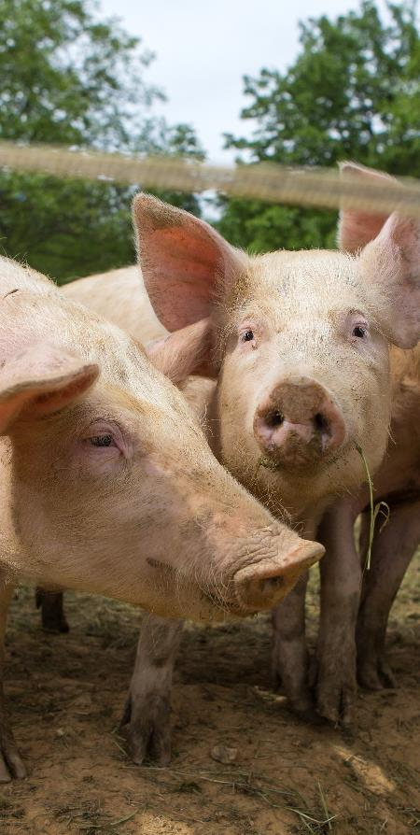
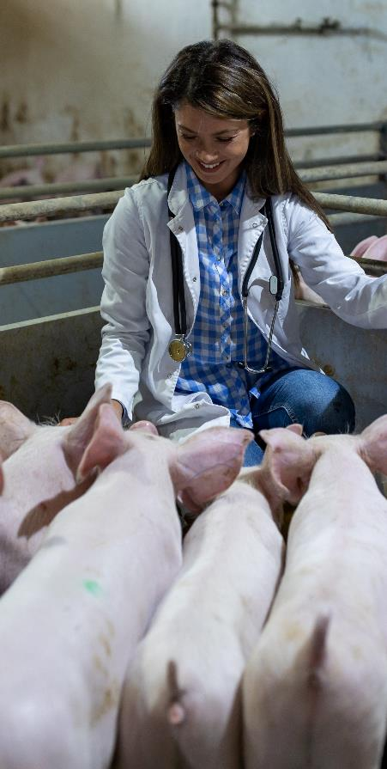
Two Images with Content
This slide is for simple text with two pictures.
  DO NOT move the title or text box.
  DO NOT place text on top of image.
  You may expand the length of this text box to fill the space from here to the bottom of the slide.

Slide 78
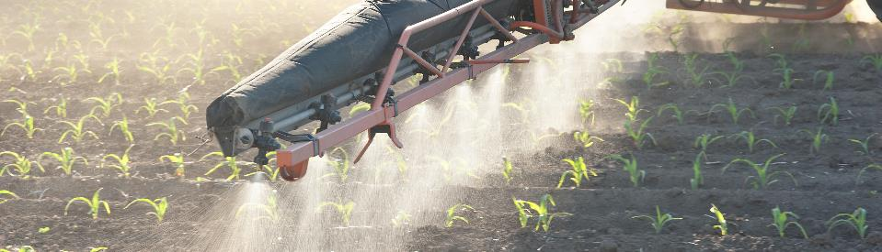


Three Images with Content
This slide is for simple text with three pictures.
  DO NOT move the title or text box.
  DO NOT place text on top of image.
  You may expand the length of this text box to fill the space from here to the bottom of the slide.

Slide 79
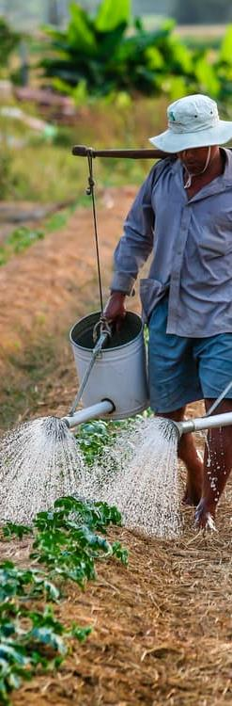


Three Images with Content
This slide is for simple text with three pictures.
  DO NOT move the title or text box.
  DO NOT place text on top of image.
  You may expand the length of this text box to fill the space from here to the bottom of the slide.

Slide 80

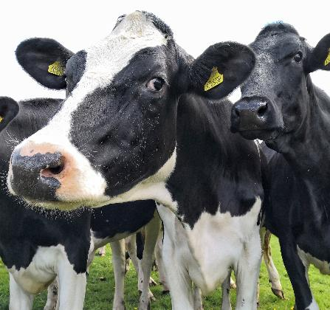
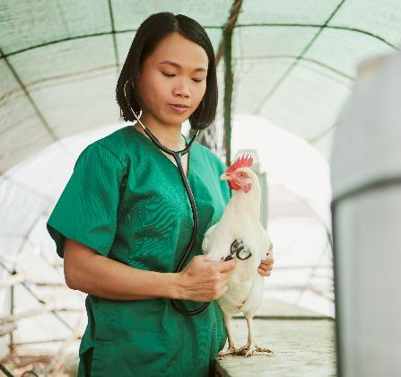
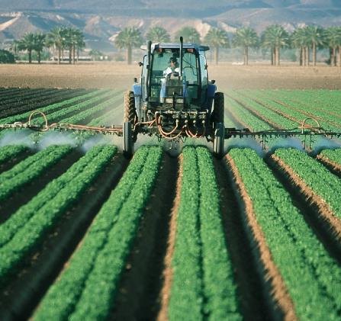
Four Images with Content
This slide is for simple text with four pictures.
  DO NOT move the title or text box.
  DO NOT place text on top of image.
  You may expand the length of this text box to fill the space from here to the bottom of the slide.

Slide 81

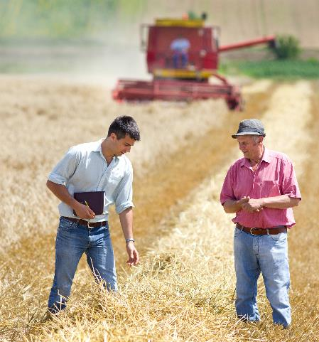

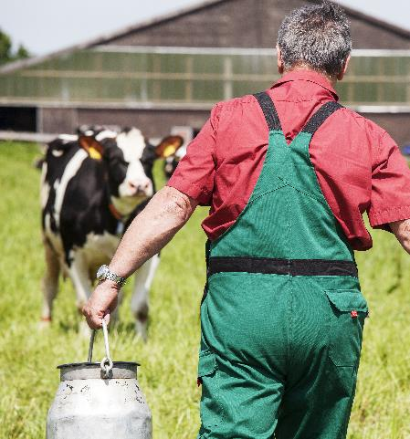
Four Images with Content
This slide is for simple text with four pictures. DO NOT move the title or text box to preserve the white space. DO NOT place text on top of the image.
You may expand the length of this text box to fill the space from here to the bottom of the slide
  Consider basic bullets

Slide 82
If You Must Include Lots of Text
THIS SLIDE IS FOR YOU
The CommsLeg Team strongly encourages you to talk through presentations and use PowerPoints for images, photos and graphs.
  Slides should include topline messages, not everything you want to say. Instead use the Notes section below to plan your talking points.
Use this slide sparingly in your presentations.
  Consider using animations to drop in the bullets as you discuss them. Here’s how:
    Click “Animations” in the top menu bar.
    Highlight the text you want to appear on the slide as you speak.
    Click “Appear” from the Animations options.
    Reorder your animations by clicking the orange number displayed next to the animated bullet.
      Click “Move Earlier” or “Move Later” under “Reorder Animation” at the top right of the menu bar.

Slide 83
Data Points & Body Text
XX Number of Items
XX Years of Study
$$ Dollars Invested
This slide is for simple data points with brief explanation text. DO NOT move the title or text box to preserve the white space. DO NOT place text on top of the image.
You may expand the length of this text box to fill the space from here to the bottom of the slide
  Consider basic bullets

Slide 84
Two Column Data
Section Header
Section Header
Use this space to
  Highlight data
  Demonstrate order
  Outline steps or process
This is what the first list level bullet looks like. Keep hitting tab to go to the next level bullet.
  Second bullet
    Third bullet

Slide 85
Three Column Data
Section Header
Section Header
Section Header
Use this space to highlight data.
Use this space to demonstrate order.
Use this space to outline steps or process.
This is what the first list level bullet looks like. Keep hitting tab to go to the next level bullet.
  Second bullet
    Third bullet
Keep text brief.

Slide 86
Four Quadrant Data
Section Header
Section Header
Use this space to highlight data.
Use this space to demonstrate order.
Use this space to outline steps or process.
This is what the first list level bullet looks like. Keep hitting tab to go to the next level bullet.
  Second bullet
    Third bullet
Section Header
Section Header
Keep text brief.
Use “Animations” as needed.

Slide 87
Chart with Text
Summarize
  What is the main point to highlight?
  What do you want your audience to remember from this chart?

Slide 88
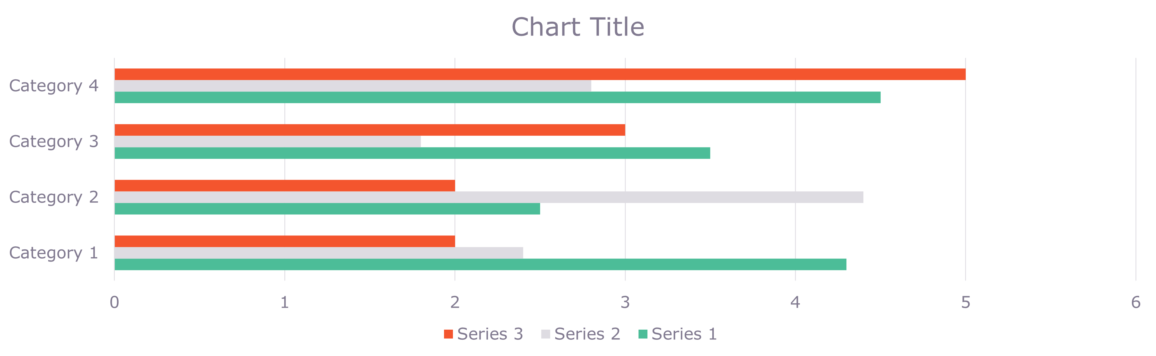
Simple Chart

Slide 89
Table with Text
Category 1 | Category 2 | Category 3 | Category 4
Summarize
  What is the main point to highlight?
  What do you want your audience to remember from this chart?

Slide 90


Universal Closing Slide
Presenter Name
  Email
  Phone Number
FOUNDATIONFAR.ORG
202.624.0700

Slide 91

Cultivating Thriving Production Systems
Presenter Name
  Email
  Phone Number
FOUNDATIONFAR.ORG
202.624.0700

Slide 92

Cultivating Thriving Production Systems
Presenter Name
  Email
  Phone Number
FOUNDATIONFAR.ORG
202.624.0700

Slide 93

Sustaining Vibrant Agroecosystems
Presenter Name
  Email
  Phone Number
FOUNDATIONFAR.ORG
202.624.0700

Slide 94

Bolstering Healthy Food Systems
Presenter Name
  Email
  Phone Number
FOUNDATIONFAR.ORG
202.624.0700

Slide 95

Strengthening the Scientific Workforce
Presenter Name
  Email
  Phone Number
FOUNDATIONFAR.ORG
202.624.0700

